Slide 1


Lecture 4
DLI
Random Variables
随机变量

Slide 2
DLI
Outline
Random Variables 随机变量
Discrete Random Variables 离散型随机变量
Expected Value, Variance 期望和方差
The Bernoulli and Binomial Random Variables
The Poisson Random Variable 泊松分布
Cumulative Distribution Variance Function 累积分布函数

Slide 3
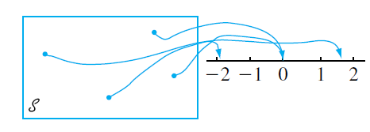
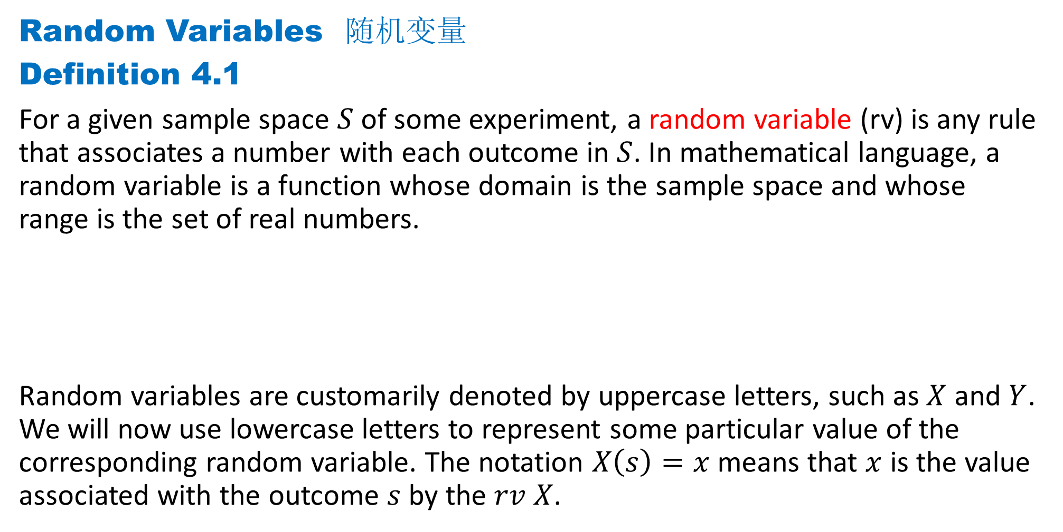
DLI
Random Variables 随机变量
Definition 4.1
For a given sample space $S$ of some experiment, a random variable (rv) is any rule that associates a number with each outcome in $S$. In mathematical language, a random variable is a function whose domain is the sample space and whose range is the set of real numbers.
Random variables are customarily denoted by uppercase letters, such as $X$ and $Y$. We will now use lowercase letters to represent some particular value of the corresponding random variable. The notation $X\left(s\right)=x$means that $x$ is the value associated with the outcome $s$ by the $rv X$.

Slide 4
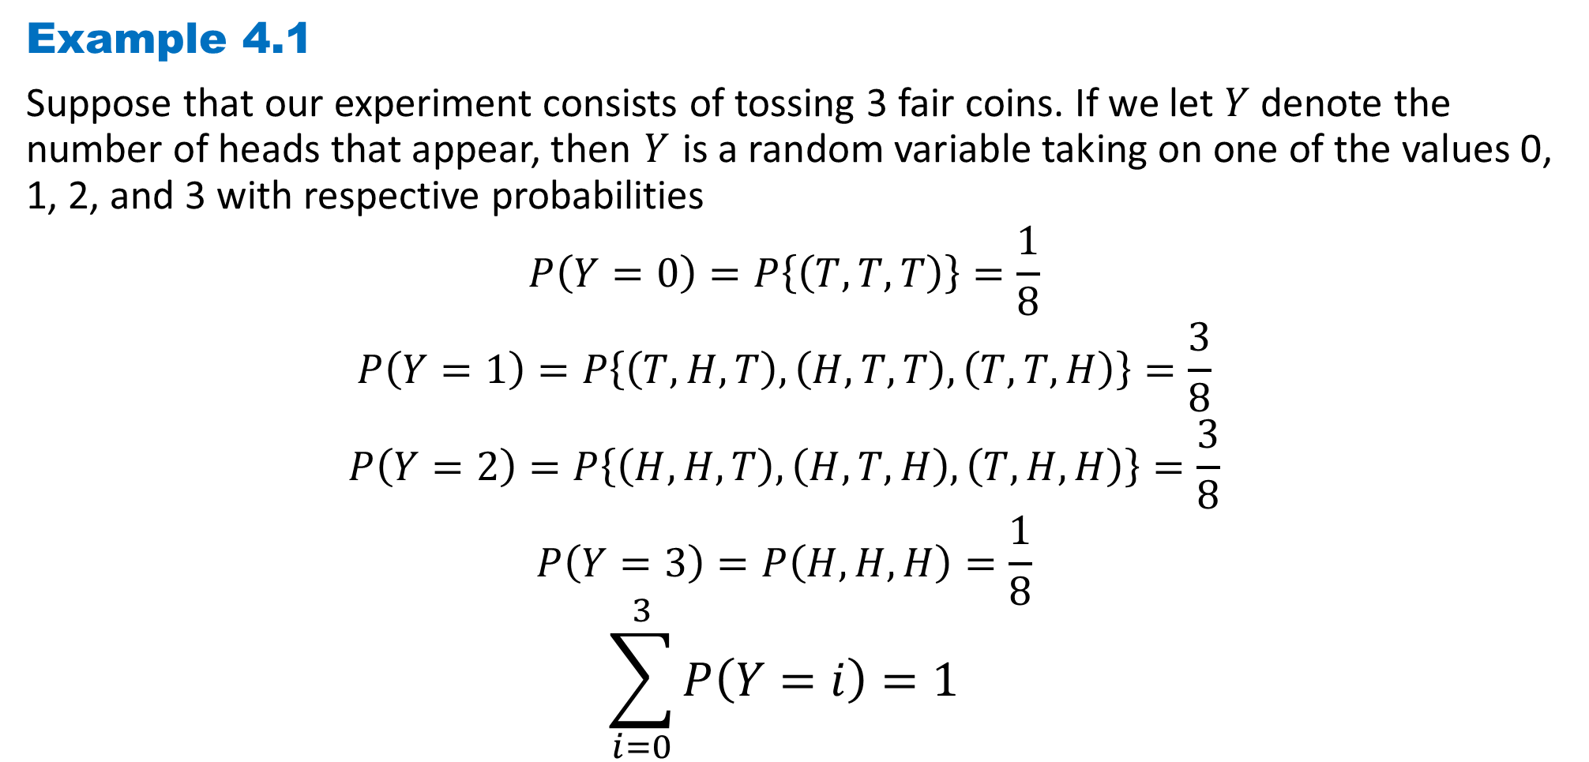
DLI
Example 4.1
Suppose that our experiment consists of tossing 3 fair coins. If we let $Y$ denote the number of heads that appear, then $Y$ is a random variable taking on one of the values 0, 1, 2, and 3 with respective probabilities
$$P\left(Y=0\right)=P\left\{\left(T,T,T\right)\right\}=\frac{1}{8}$$
$$P\left(Y=1\right)=P\left\{\left(T,H,T\right),\left(H,T,T\right),\left(T,T,H\right)\right\}=\frac{3}{8}$$
$$P\left(Y=2\right)=P\left\{\left(H,H,T\right),\left(H,T,H\right),\left(T,H,H\right)\right\}=\frac{3}{8}$$
$$P\left(Y=3\right)=P\left(H,H,H\right)=\frac{1}{8}$$
$$\sum_{i=0}^{3}{P\left(Y=i\right)}=1$$

Slide 5

DLI
Definition 4.2
Any random variable whose only possible values are $0$ and $1$ is called a Bernoulli
random variable.

Slide 6
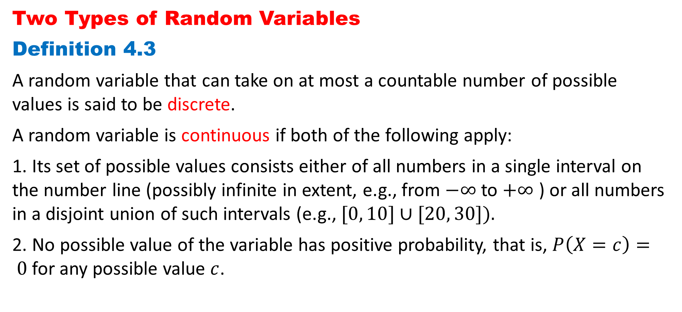
DLI
Two Types of Random Variables
Definition 4.3
A random variable that can take on at most a countable number of possible values is said to be discrete.
A random variable is continuous if both of the following apply:
1. Its set of possible values consists either of all numbers in a single interval on the number line (possibly infinite in extent, e.g., from $−∞$ to $+∞$ ) or all numbers in a disjoint union of such intervals (e.g., $[0, 10]∪[20, 30]).$
2. No possible value of the variable has positive probability, that is, $P\left(X=c\right)= 0$ for any possible value $c$.

Slide 7
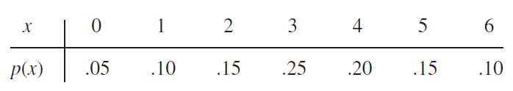
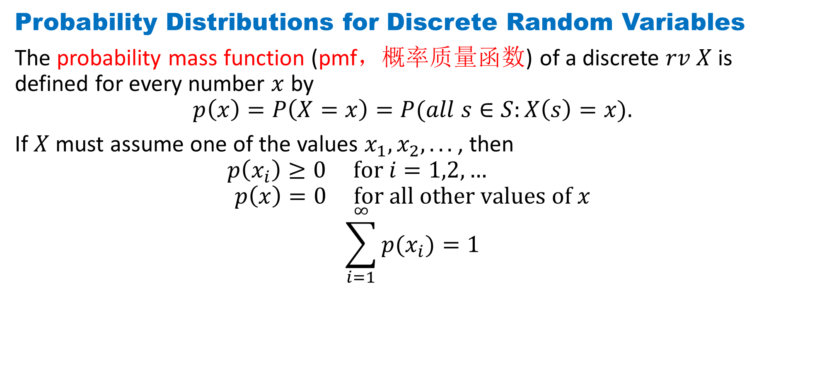
DLI
Probability Distributions for Discrete Random Variables
The probability mass function (pmf，概率质量函数) of a discrete $rv$ $X$is defined for every number $x$ by
$$p\left(x\right)=P\left(X=x\right)=P(all s∈S:X\left(s\right)=x).$$
If $X$ must assume one of the values $x_{1}, x_{2}, . ..$, then
$$p\left(x_{i}\right)≥0 for i=1,2,…$$
$$p\left(x\right)=0 for all other values of x$$
$$\sum_{i=1}^{∞}{p(x_{i})}=1$$

Slide 8
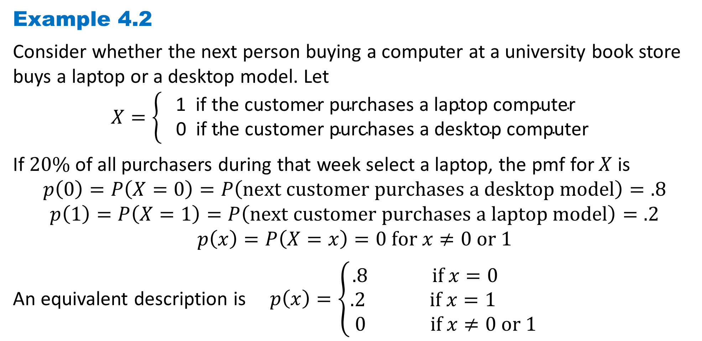
DLI
Example 4.2
Consider whether the next person buying a computer at a university book store buys a laptop or a desktop model. Let
$$X=\left\{\begin{aligned}\text{1} \text{if} \text{the} \text{customer} \text{purchases} \text{a} \text{laptop} \text{computer} \\ \text{0 } \text{if} \text{the} \text{customer} \text{purchases} \text{a} \text{desktop} \text{computer} \end{aligned}\right.$$
If $20\%$ of all purchasers during that week select a laptop, the pmf for $X$ is
$$p\left(0\right)=P\left(X=0\right)=P\left(next customer purchases a desktop model\right)=.8$$
$$p\left(1\right)=P\left(X=1\right)=P\left(next customer purchases a laptop model\right)=.2$$
$$p\left(x\right)=P\left(X=x\right)=0 for x≠0 or 1$$
An equivalent description is $p\left(x\right)=\left\{\begin{aligned}.8 if x=0 \\ .2 if x=1 \\ 0 if x≠0 or 1 \end{aligned}\right.$

Slide 9
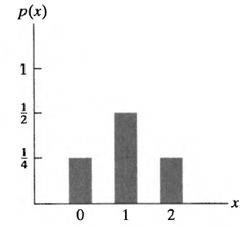
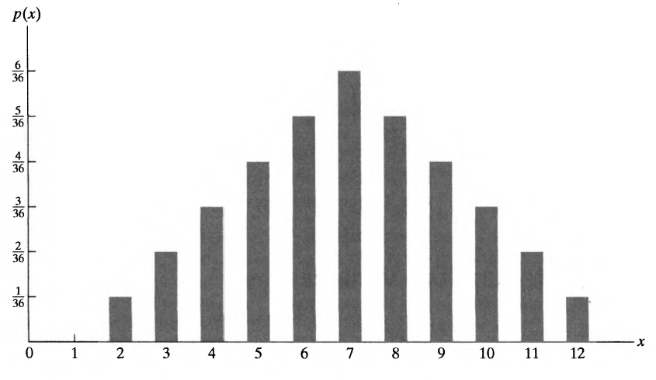

DLI
It is often instructive to present the probability mass function in a graphical format by plotting $p(x_{i})$ on the $y$-axis against $x_{i}$ on the $x$-axis.

Slide 10
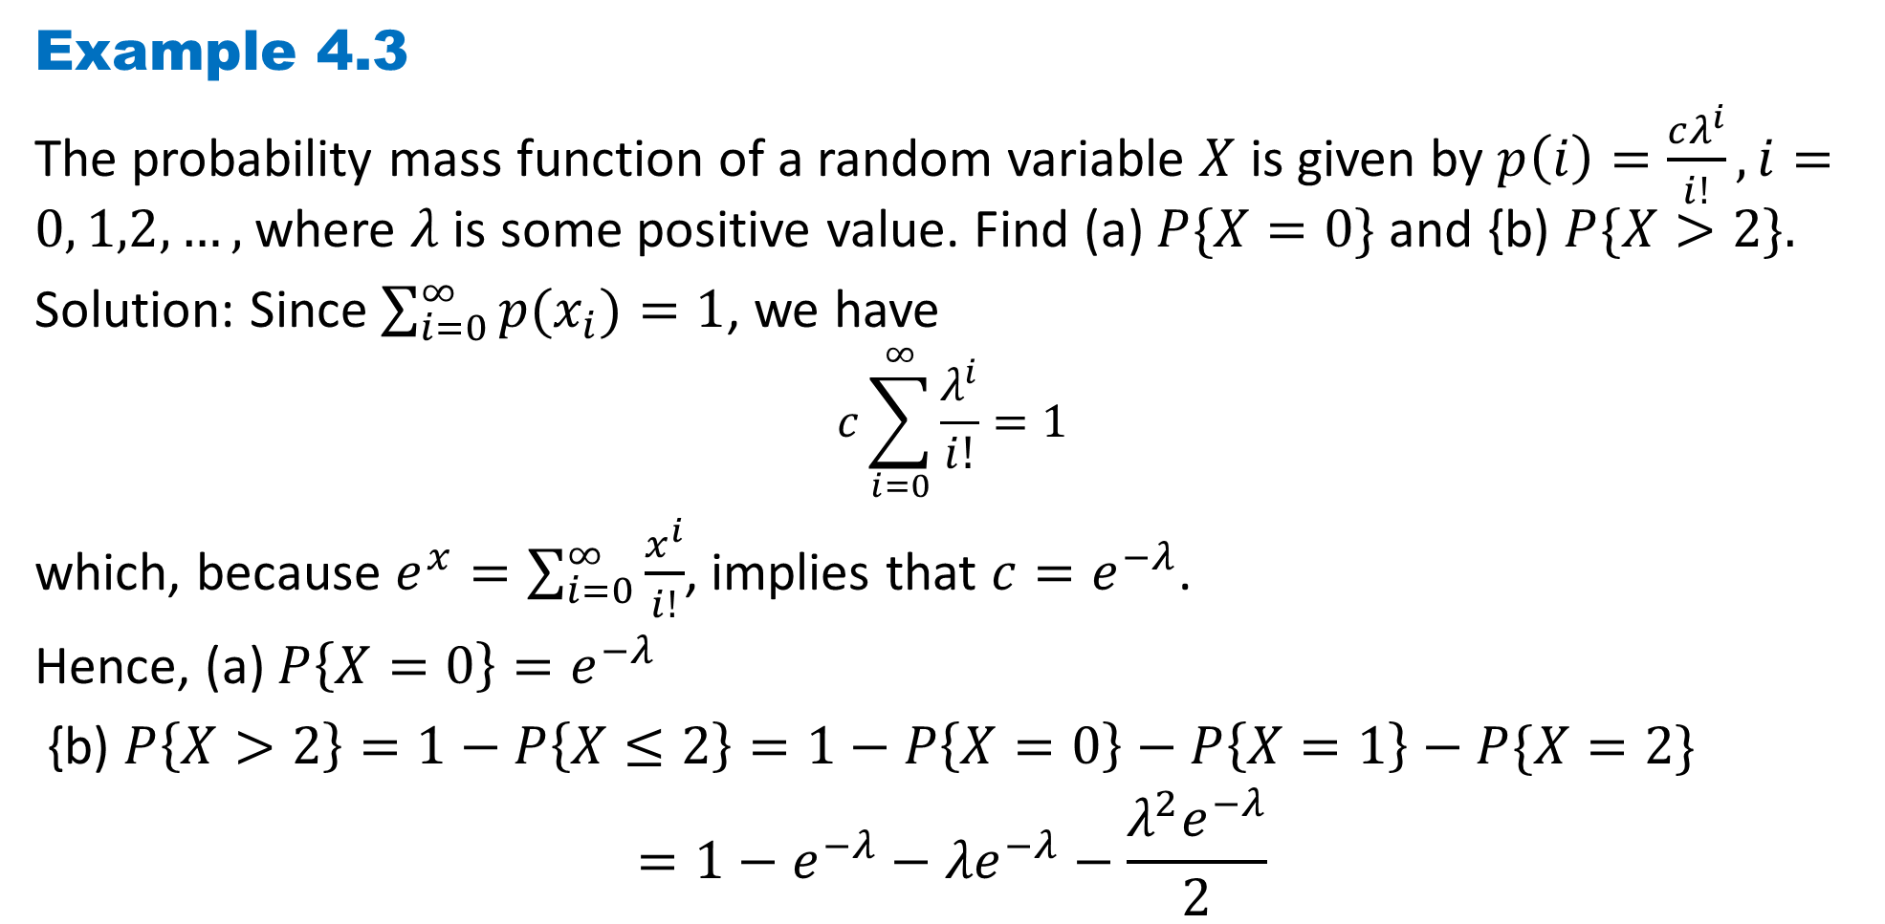
DLI
Example 4.3
The probability mass function of a random variable $X$ is given by $p\left(i\right)=\frac{cλ^{i}}{i!}, i=0, 1,2, …,$where $λ$ is some positive value. Find (a) $P\{X=0\}$and {b) $P\{X>2\}.$
Solution: Since $\sum_{i=0}^{∞}{p(x_{i})}=1$, we have
$$c\sum_{i=0}^{∞}{\frac{λ^{i}}{i!}}=1$$
which, because $e^{x}=\sum_{i=0}^{∞}{\frac{x^{i}}{i!}}$, implies that $c=e^{−λ}$.
Hence, (a) $P\left\{X=0\right\}=e^{−λ}$
{b) $P\left\{X>2\right\}=1−P\left\{X≤2\right\}=1−P\left\{X=0\right\}−P\left\{X=1\right\}−P\{X=2\}$
$$=1−e^{−λ}−{λe}^{−λ}−\frac{{λ^{2}e}^{−λ}}{2}$$

Slide 11
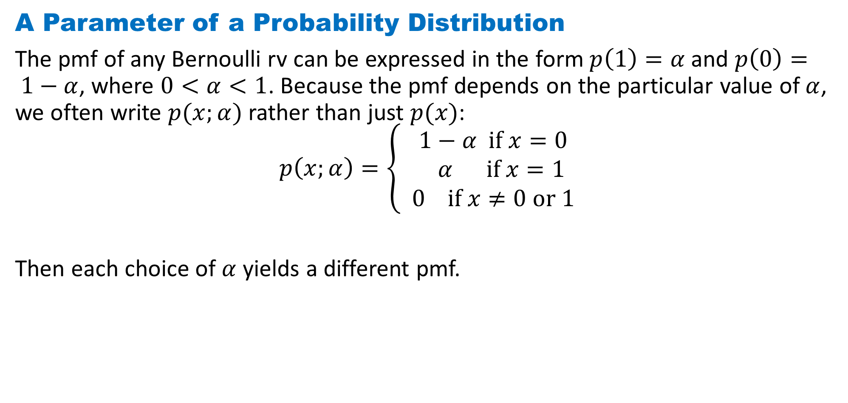
DLI
A Parameter of a Probability Distribution
The pmf of any Bernoulli rv can be expressed in the form $p\left(1\right)=α$and $p\left(0\right)= 1−α$, where $0<α<1$. Because the pmf depends on the particular value of $α$, we often write $p(x;α)$rather than just $p(x)$:
$$p\left(x;α\right)=\left\{ \begin{aligned}1−α if x=0 \\ α if x=1 \\ 0 if x≠0 or 1\end{aligned}\right.$$
Then each choice of $α$ yields a different pmf.

Slide 12
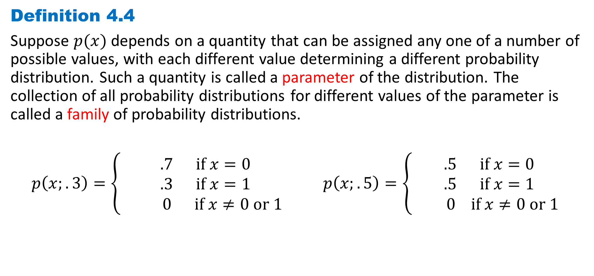
DLI
Definition 4.4
Suppose $p(x)$depends on a quantity that can be assigned any one of a number of possible values, with each different value determining a different probability distribution. Such a quantity is called a parameter of the distribution. The collection of all probability distributions for different values of the parameter is called a family of probability distributions.
$p\left(x;.3\right)=\left\{ \begin{aligned}.7 if x=0 \\ .3 if x=1 \\ 0 if x≠0 or 1\end{aligned}\right. p\left(x;.5\right)=\left\{ \begin{aligned}.5 if x=0 \\ .5 if x=1 \\ 0 if x≠0 or 1\end{aligned}\right.$

Slide 13
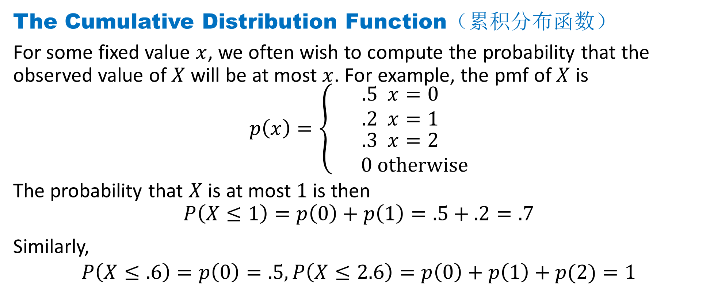
DLI
The Cumulative Distribution Function（累积分布函数）
For some fixed value $x$, we often wish to compute the probability that the observed value of $X$ will be at most $x$. For example, the pmf of $X$ is
$$p\left(x\right)=\left\{\begin{aligned}\begin{matrix}.5 x=0 \\ .2 x=1\end{matrix} \\ \begin{matrix}.3 x=2 \\ 0 otherwise\end{matrix}\end{aligned}\right.$$
The probability that $X$ is at most $1$ is then
$$P\left(X≤1\right)=p\left(0\right)+p\left(1\right)=.5+.2=.7$$
Similarly,
$$P\left(X≤.6\right)=p\left(0\right)=.5,P\left(X≤2.6\right)=p\left(0\right)+p\left(1\right)+p(2)=1$$

Slide 14
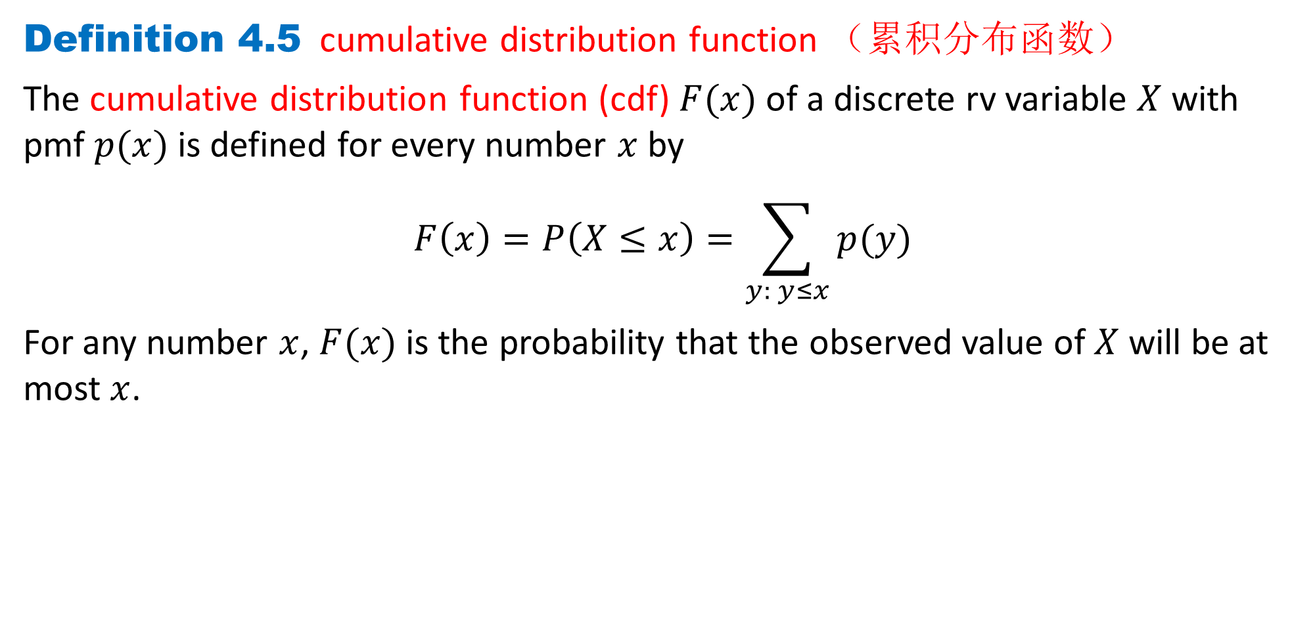
DLI
Definition 4.5 cumulative distribution function （累积分布函数）
The cumulative distribution function (cdf) $F(x)$of a discrete rv variable $X$ with pmf $p(x)$is defined for every number $x$ by
$$F\left(x\right)=P\left(X≤x\right)=\sum_{y: y≤x}{p(y)}$$
For any number $x$, $F(x)$ is the probability that the observed value of $X$ will be at most $x$.

Slide 15
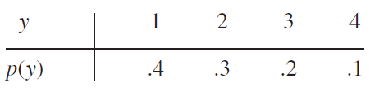
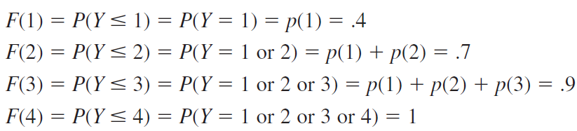

DLI
Example 4.4
If
We first determine $F(y)$for each value in the set {$1, 2, 3, 4$} of possible values:
Now for any other number $y$, $F(y)$ will equal the value of $F$ at the closest possible value of $Y$ to the left of $y$. For example, $F(2.7)=P(Y≤2.7)=P(Y≤2)=.7$, and $F(3.999)=F(3)=.9.$

Slide 16
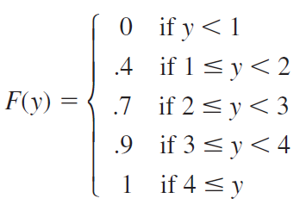
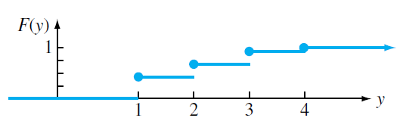

DLI
The cdf is thus
A graph of $F(y)$is

Slide 17
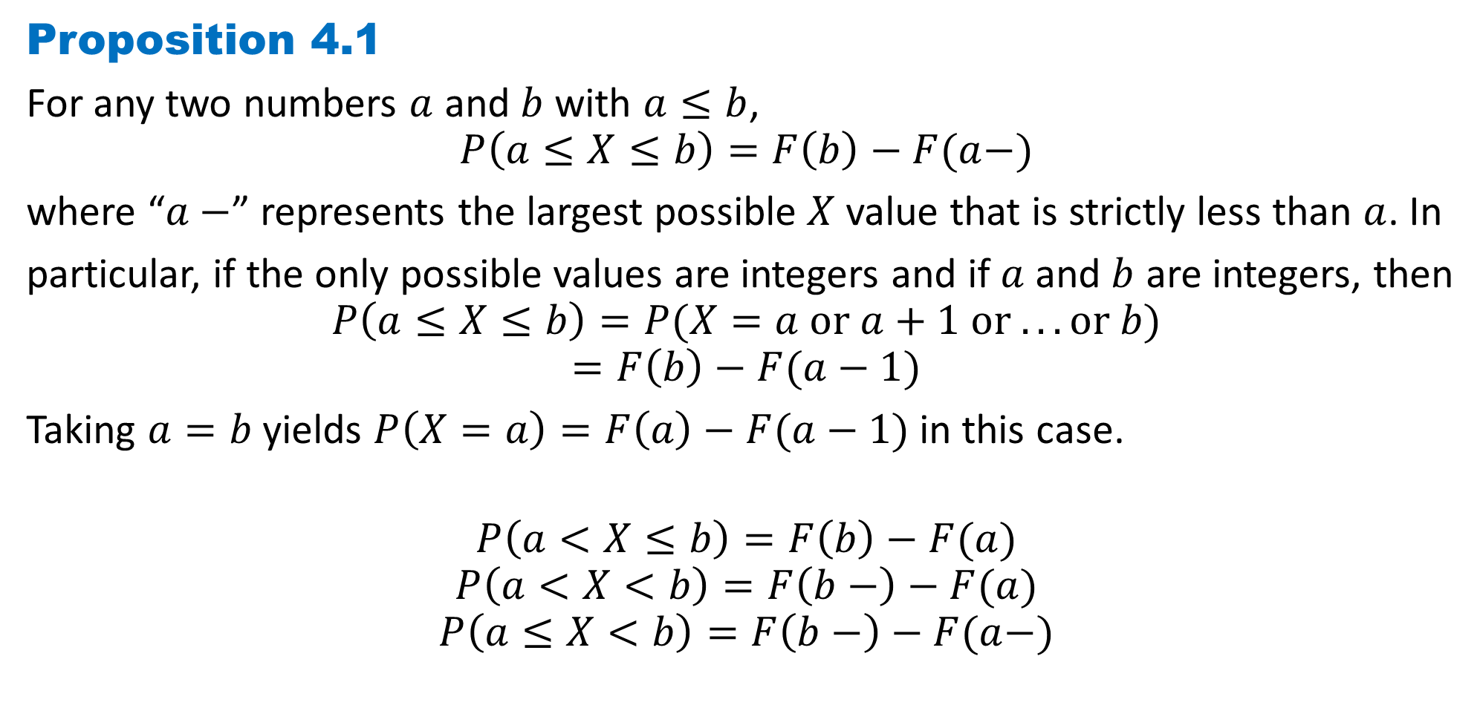
DLI
Proposition 4.1
For any two numbers $a$ and $b$ with $a≤b$,
$$P\left(a≤X≤b\right)=F\left(b\right)−F(a−)$$
where “$a−$” represents the largest possible $X$value that is strictly less than $a$. In
particular, if the only possible values are integers and if $a$and $b$ are integers, then
$$P\left(a≤X≤b\right)=P(X=a or a+1 or . . . or b)$$
$$=F\left(b\right)−F(a−1)$$
Taking $a=b$yields $P\left(X=a\right)=F\left(a\right)−F(a−1)$in this case.
$$P\left(a<X≤b\right)=F\left(b\right)−F(a)$$
$$P\left(a<X<b\right)=F\left(b−\right)−F(a)$$
$$P\left(a≤X<b\right)=F\left(b−\right)−F(a−)$$

Slide 18
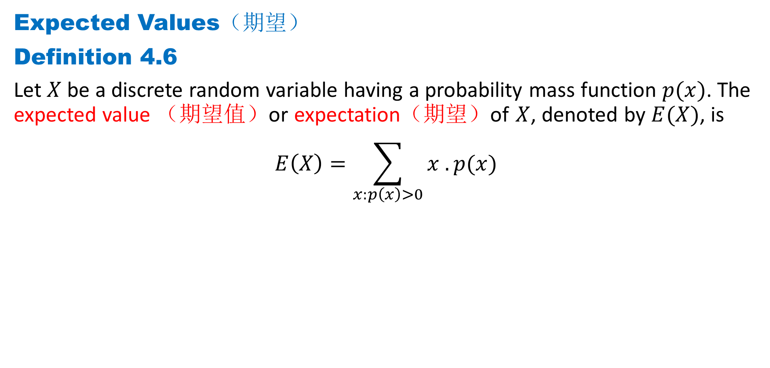
DLI
Expected Values（期望）
Definition 4.6
Let $X$ be a discrete random variable having a probability mass function $p(x)$. The expected value （期望值）or expectation（期望）of $X$, denoted by $E(X)$, is
$$E\left(X\right)=\sum_{x:p\left(x\right)>0}{x . p(x) }$$

Slide 19

DLI
Example 4.5
The pmf of Bernoulli random variable is
$$p(x)=\left\{\begin{aligned}p x=1 \\ 1−p x=0 \end{aligned}\right.$$
Then,
$$E\left(X\right)=p∙1+\left(1−p\right)∙0=p$$

Slide 20
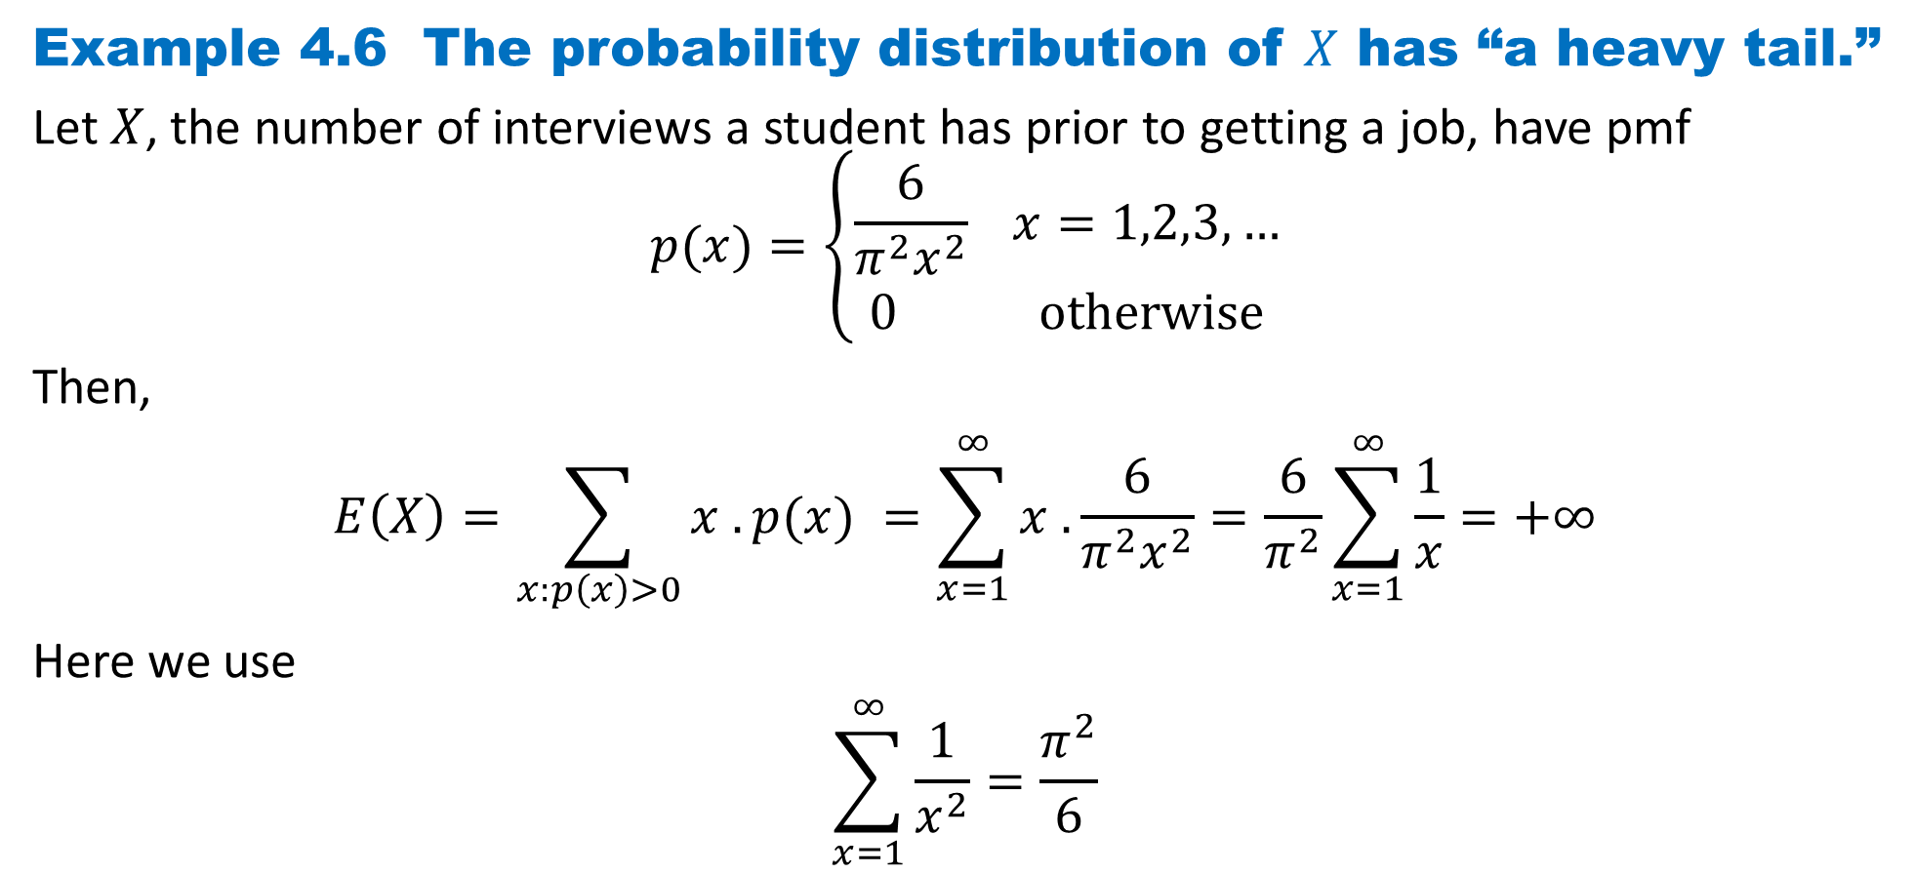
DLI
Example 4.6 The probability distribution of $X$ has “a heavy tail.”
Let $X$, the number of interviews a student has prior to getting a job, have pmf
$$p(x)=\left\{\begin{aligned}\frac{6}{π^{2}x^{2}} x=1,2,3,… \\ 0 otherwise\end{aligned}\right.$$
Then,
$$E\left(X\right)=\sum_{x:p\left(x\right)>0}{x . p(x) }=\sum_{x=1}^{∞}{x .\frac{6}{π^{2}x^{2}}}=\frac{6}{π^{2}}\sum_{x=1}^{∞}{\frac{1}{x}=+∞}$$
Here we use
$$\sum_{x=1}^{∞}{\frac{1}{x^{2}}}=\frac{π^{2}}{6}$$

Slide 21
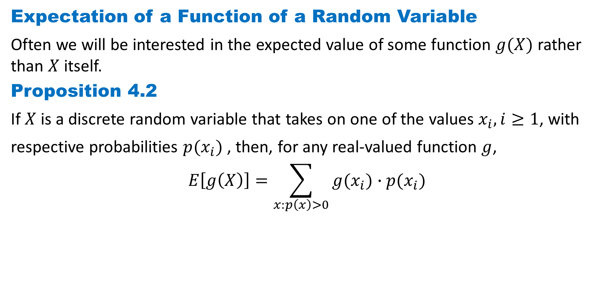
DLI
Expectation of a Function of a Random Variable
Often we will be interested in the expected value of some function $g(X)$ rather than $X$ itself.
Proposition 4.2
If $X$ is a discrete random variable that takes on one of the values $x_{i}, i≥1$, with
respective probabilities $p(x_{i})$, then, for any real-valued function $g$,
$$E\left[g\left(X\right)\right]=\sum_{x:p\left(x\right)>0}{g(x_{i})∙p(x_{i}) }$$

Slide 22
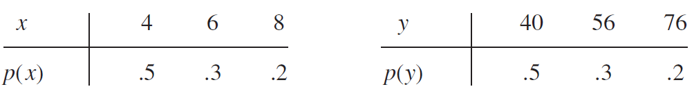
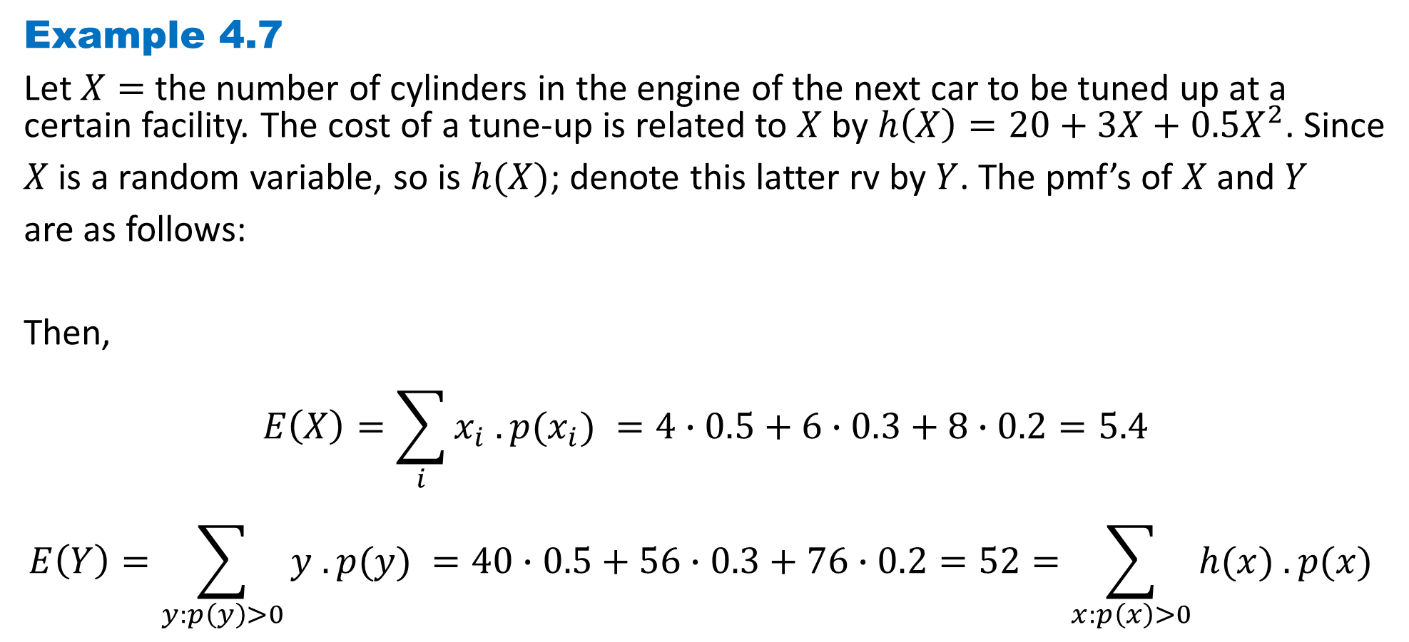
DLI
Example 4.7
Let $X=$the number of cylinders in the engine of the next car to be tuned up at a certain facility. The cost of a tune-up is related to $X$ by $h\left(X\right)=20+3X+0.5X^{2}$. Since
$X$ is a random variable, so is $h(X)$; denote this latter rv by $Y$. The pmf’s of $X$ and $Y$
are as follows:
Then,
$$E\left(X\right)=\sum_{i}{x_{i} . p(x_{i}) }=4∙0.5+6∙0.3+8∙0.2=5.4$$
$$E\left(Y\right)=\sum_{y:p\left(y\right)>0}{y . p(y) }=40∙0.5+56∙0.3+76∙0.2=52=\sum_{x:p\left(x\right)>0}{h(x) . p(x) }$$

Slide 23
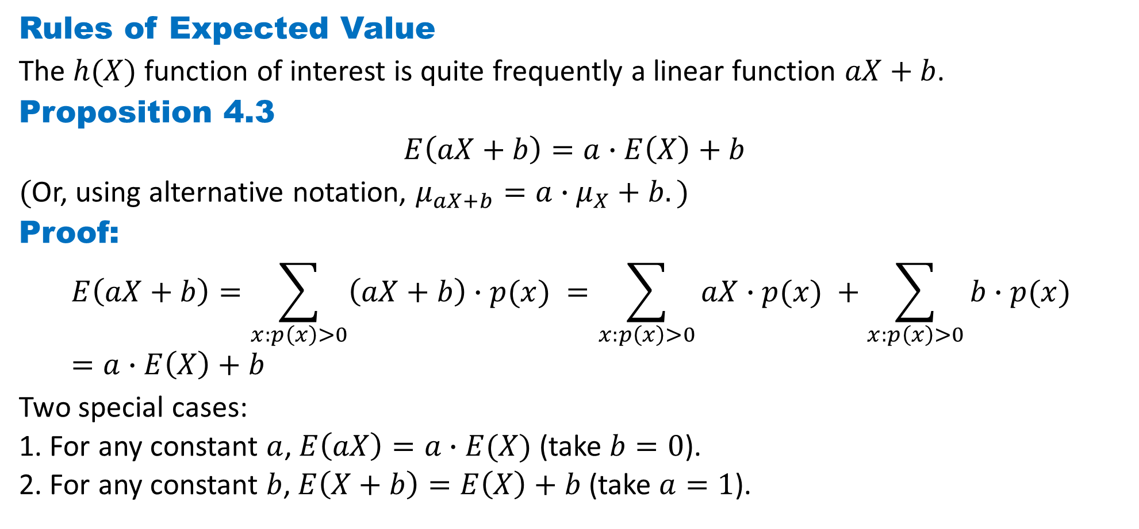
DLI
Rules of Expected Value
The $h(X)$ function of interest is quite frequently a linear function $aX+b$.
Proposition 4.3
$$E\left(aX+b\right)=a∙E\left(X\right)+b$$
$($Or, using alternative notation, $μ_{aX+b}=a∙μ_{X}+b.)$
Proof:
$$E\left(aX+b\right)=\sum_{x:p\left(x\right)>0}{\left(aX+b\right)∙p(x) }=\sum_{x:p\left(x\right)>0}{aX∙p(x) }+\sum_{x:p\left(x\right)>0}{b∙p(x) }=a∙E\left(X\right)+b$$
Two special cases:
1. For any constant $a$, $E\left(aX\right)=a∙E(X)$(take $b=0$).
2. For any constant $b$, $E\left(X+b\right)=E\left(X\right)+b$(take $a=1$).

Slide 24
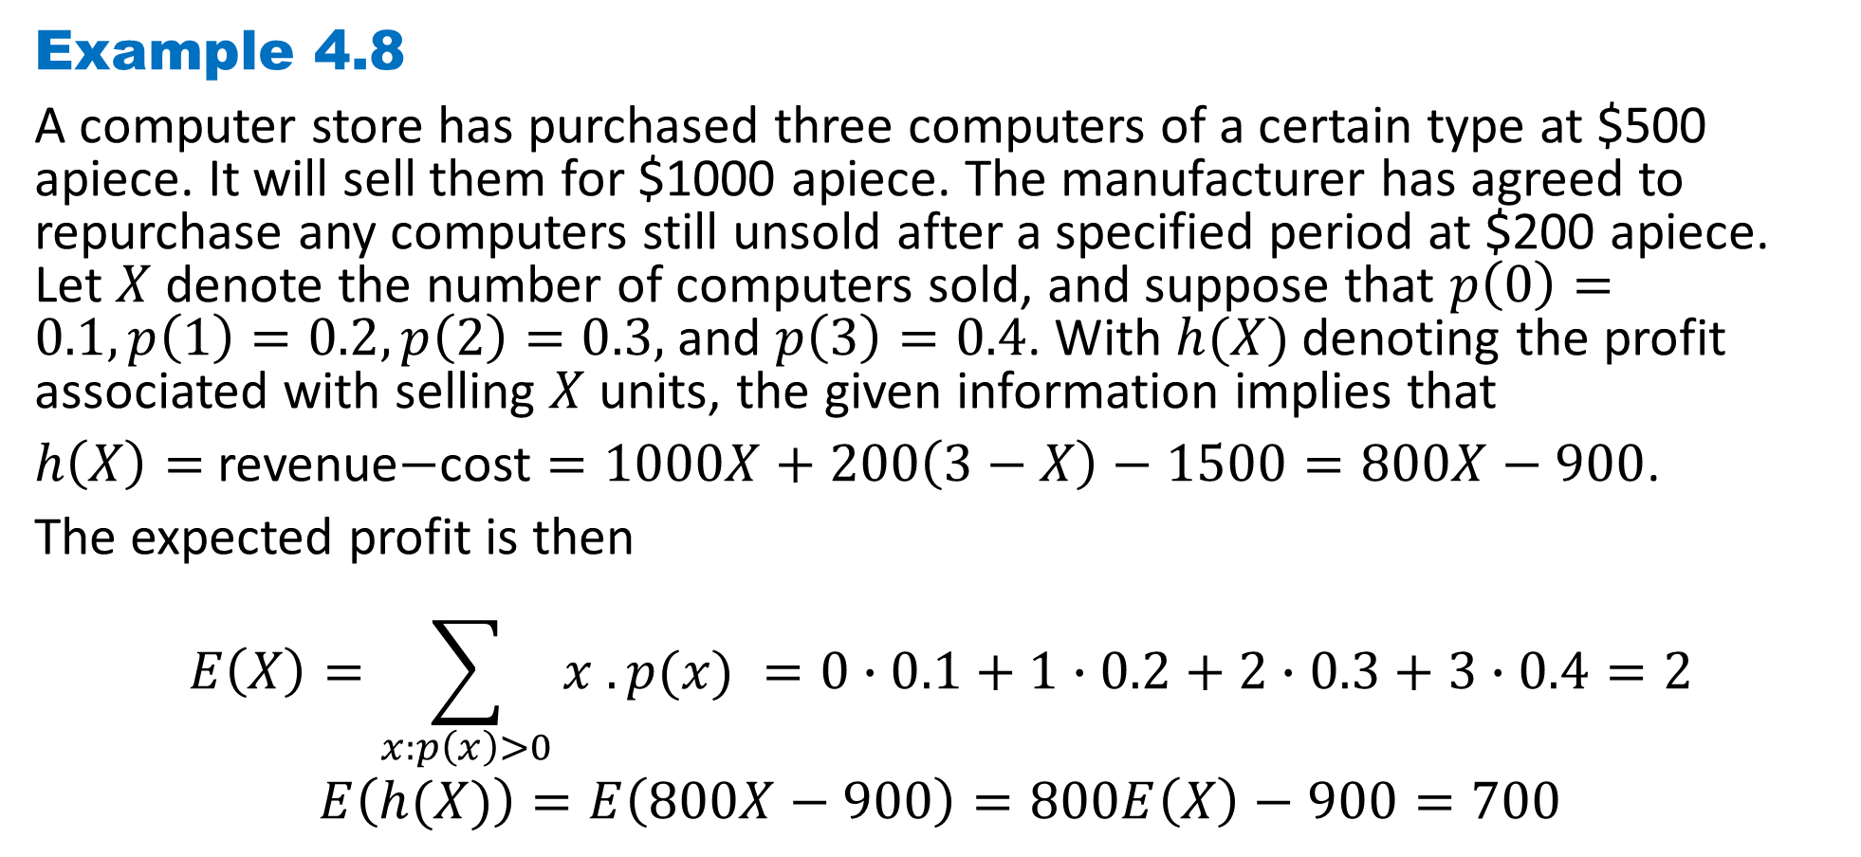
DLI
Example 4.8
A computer store has purchased three computers of a certain type at $500 apiece. It will sell them for $1000 apiece. The manufacturer has agreed to repurchase any computers still unsold after a specified period at $200 apiece. Let $X$ denote the number of computers sold, and suppose that $p\left(0\right)=0.1, p\left(1\right)=0.2, p\left(2\right)=0.3,$and $p\left(3\right)=0.4$. With $h(X)$denoting the profit associated with selling $X$ units, the given information implies that
$h\left(X\right)=$ revenue$−$cost $=1000X+200\left(3−X\right)−1500=800X−900$.
The expected profit is then
$$E\left(X\right)=\sum_{x:p\left(x\right)>0}{x . p(x) }=0∙0.1+1∙0.2+2∙0.3+3∙0.4=2$$
$$E\left(h(X)\right)=E\left(800X−900\right)=800E\left(X\right)−900=700$$

Slide 25
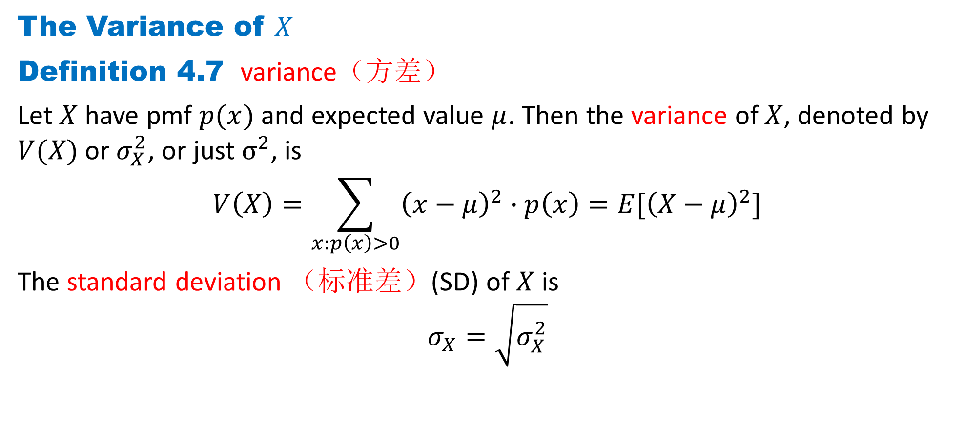
DLI
The Variance of $X$
Definition 4.7 variance（方差）
Let $X$ have pmf $p(x)$ and expected value $μ$. Then the variance of $X$, denoted by $V(X)$or $σ_{X}^{2}$, or just $σ^{2}$, is
$$V\left(X\right)=\sum_{x:p\left(x\right)>0}{{\left(x−μ\right)}^{2}∙p\left(x\right)}=E[{\left(X−μ\right)}^{2}]$$
The standard deviation （标准差）(SD) of $X$ is
$$σ_{X}=\sqrt{σ_{X}^{2}}$$

Slide 26

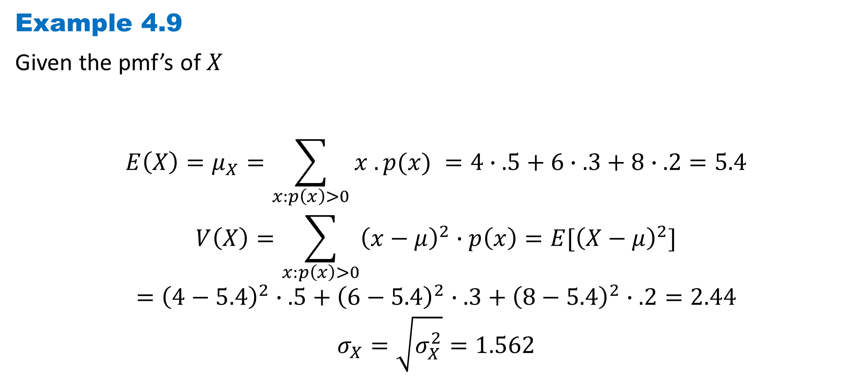
DLI
Example 4.9
Given the pmf’s of $X$
$$E\left(X\right)=μ_{X}=\sum_{x:p\left(x\right)>0}{x . p(x) }=4∙.5+6∙.3+8∙.2=5.4$$
$$V\left(X\right)=\sum_{x:p\left(x\right)>0}{{\left(x−μ\right)}^{2}∙p\left(x\right)}=E[{\left(X−μ\right)}^{2}]$$
$$={\left(4−5.4\right)}^{2}∙.5+{\left(6−5.4\right)}^{2}∙.3+{\left(8−5.4\right)}^{2}∙.2=2.44$$
$$σ_{X}=\sqrt{σ_{X}^{2}}=1.562$$

Slide 27
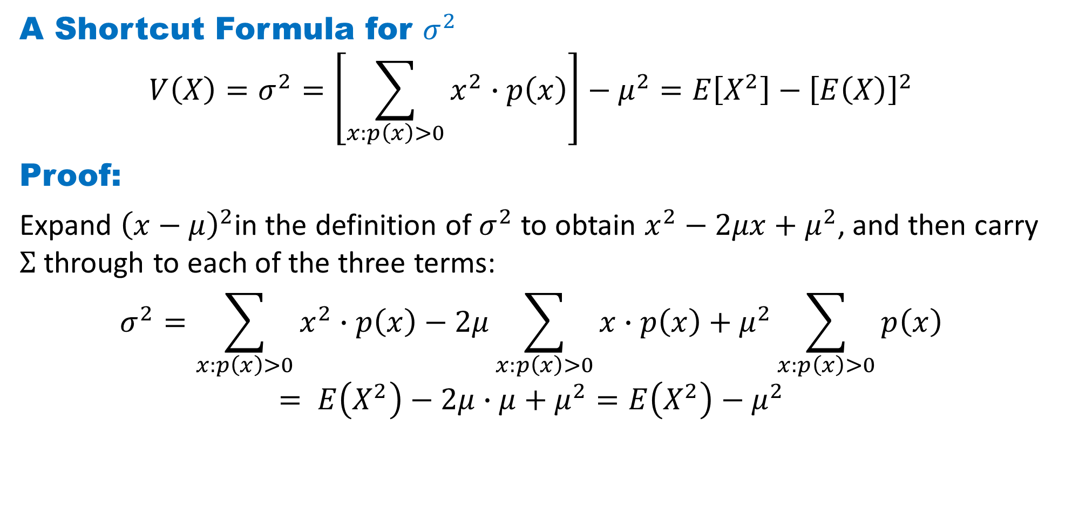
DLI
A Shortcut Formula for $σ^{2}$
$$V\left(X\right)=σ^{2}=\left[\sum_{x:p\left(x\right)>0}{x^{2}∙p\left(x\right)}\right]−μ^{2}=E\left[X^{2}\right]−{\left[E\left(X\right)\right]}^{2}$$
Proof:
Expand ${\left(x−μ\right)}^{2}$in the definition of $σ^{2}$ to obtain $x^{2}−2μx+μ^{2}$, and then carry $Σ$ through to each of the three terms:
$$σ^{2}=\sum_{x:p\left(x\right)>0}{x^{2}∙p\left(x\right)}−2μ\sum_{x:p\left(x\right)>0}{x∙p\left(x\right)}+μ^{2}\sum_{x:p\left(x\right)>0}{p\left(x\right)}$$
$$= E\left(X^{2}\right)−2μ∙μ+μ^{2}=E\left(X^{2}\right)−μ^{2}$$

Slide 28
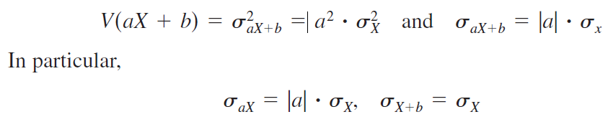
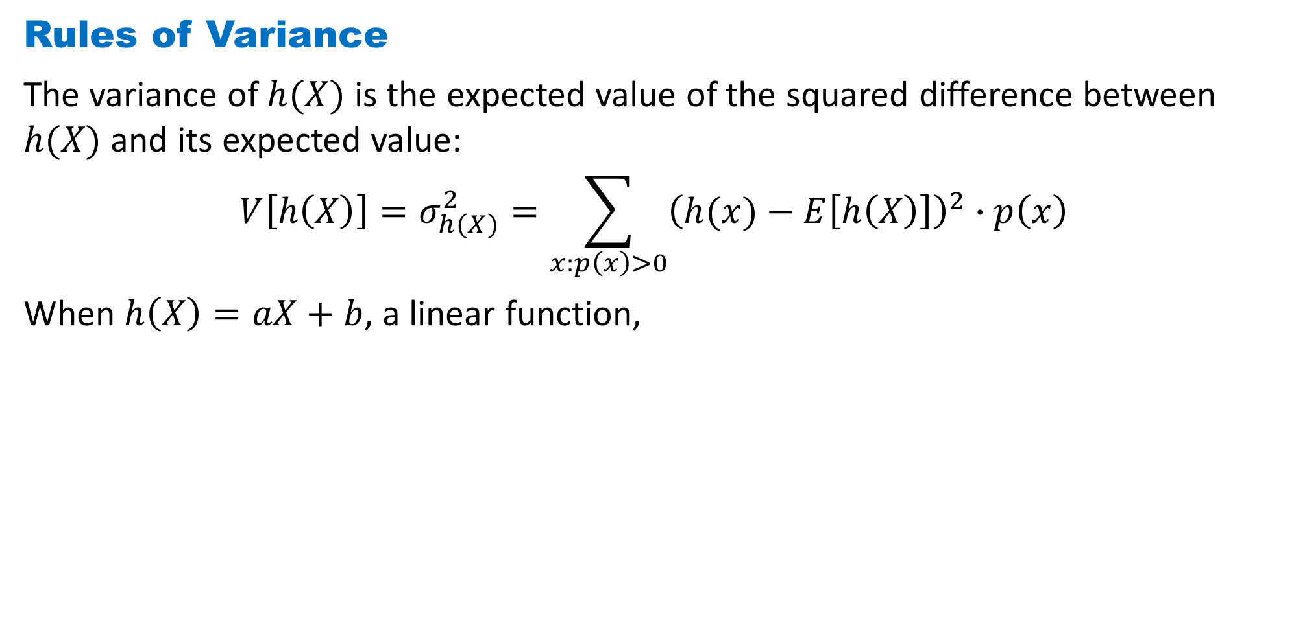
DLI
Rules of Variance
The variance of $h(X)$ is the expected value of the squared difference between $h(X)$ and its expected value:
$$V\left[h\left(X\right)\right]=σ_{h(X)}^{2}=\sum_{x:p\left(x\right)>0}{{\left(h(x)−E\left[h\left(X\right)\right]\right)}^{2}∙p\left(x\right)}$$
When $h\left(X\right)=aX+b$, a linear function,

Slide 29
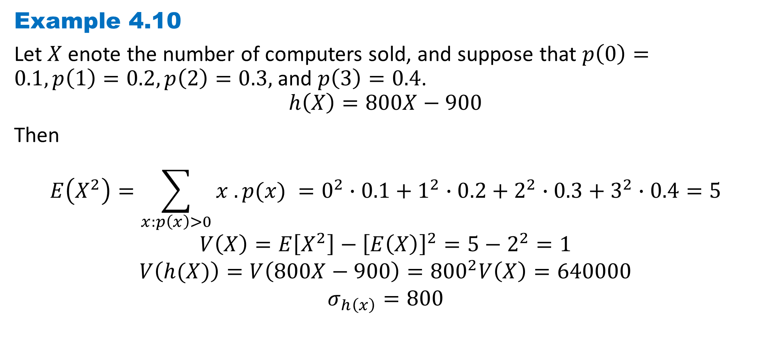
DLI
Example 4.10
Let $X$ enote the number of computers sold, and suppose that $p\left(0\right)=0.1, p\left(1\right)=0.2, p\left(2\right)=0.3,$and $p\left(3\right)=0.4$.
$$h\left(X\right)=800X−900$$
Then
$$E\left(X^{2}\right)=\sum_{x:p\left(x\right)>0}{x . p(x) }=0^{2}∙0.1+1^{2}∙0.2+2^{2}∙0.3+3^{2}∙0.4=5$$
$$V\left(X\right)=E\left[X^{2}\right]−{\left[E\left(X\right)\right]}^{2}=5−2^{2}=1$$
$$V\left(h(X)\right)=V\left(800X−900\right)={800}^{2}V\left(X\right)=640000$$
$$σ_{h\left(x\right)}=800$$

Slide 30
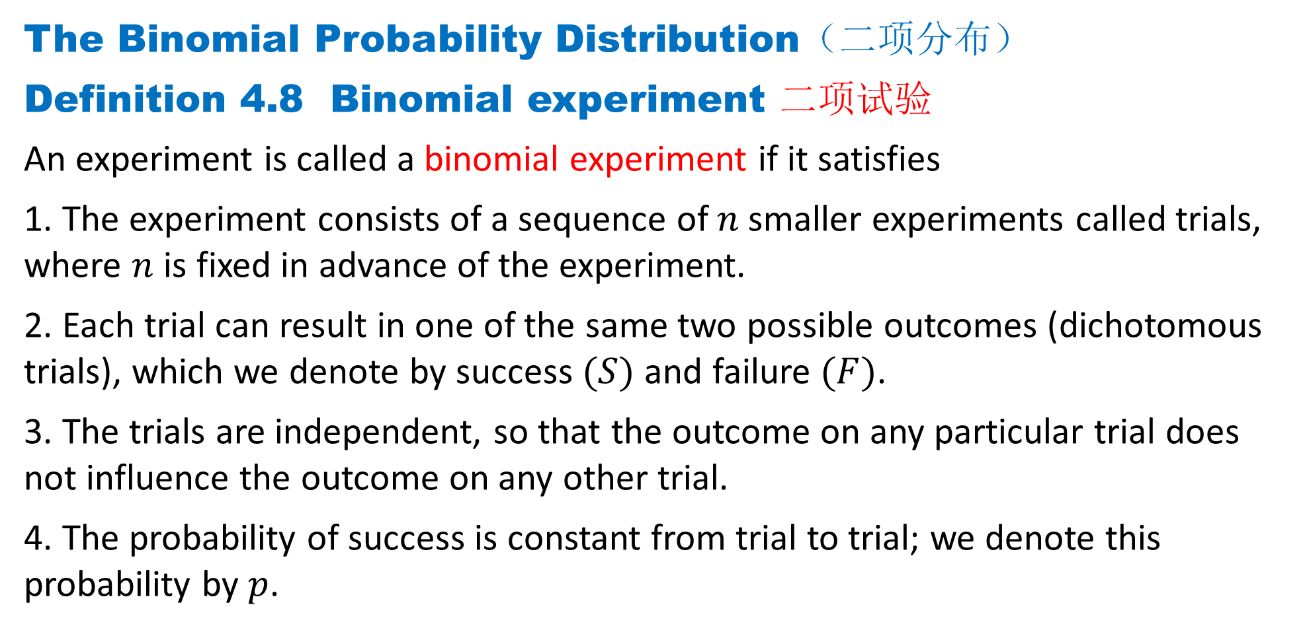
DLI
The Binomial Probability Distribution（二项分布）
Definition 4.8 Binomial experiment 二项试验
An experiment is called a binomial experiment if it satisfies
1. The experiment consists of a sequence of $n$smaller experiments called trials, where $n$ is fixed in advance of the experiment.
2. Each trial can result in one of the same two possible outcomes (dichotomous trials), which we denote by success $(S)$ and failure $(F)$.
3. The trials are independent, so that the outcome on any particular trial does not influence the outcome on any other trial.
4. The probability of success is constant from trial to trial; we denote this probability by $p$.

Slide 31
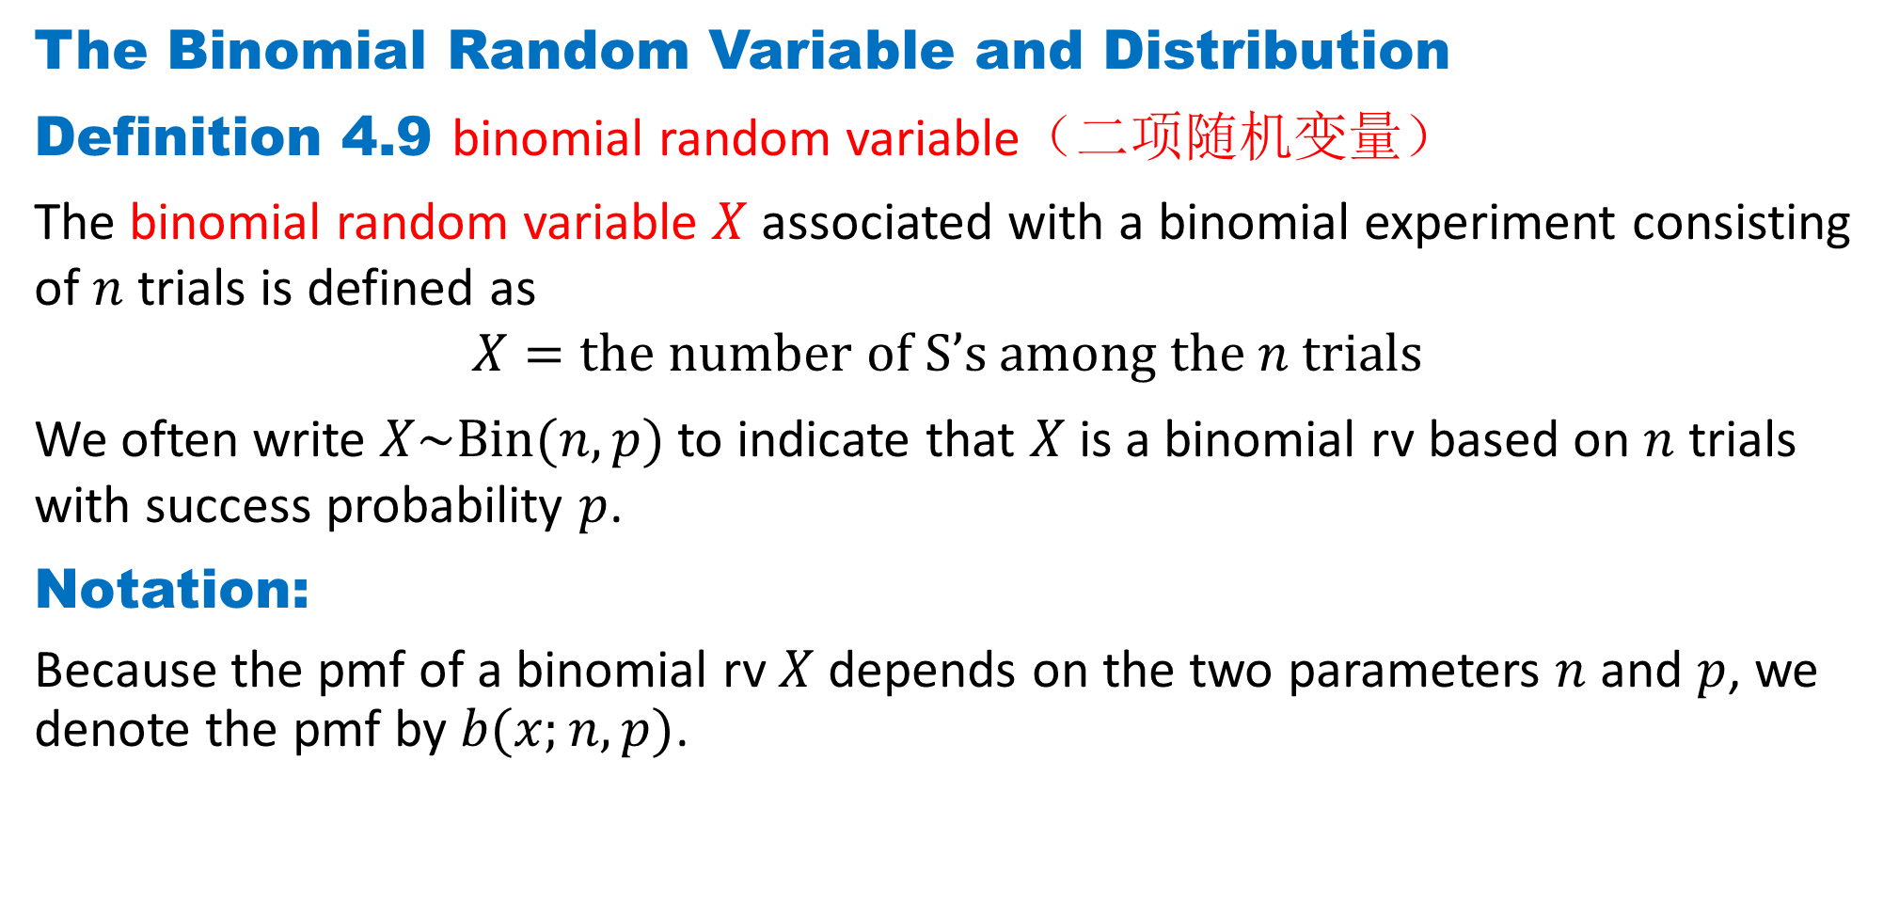
DLI
The Binomial Random Variable and Distribution
Definition 4.9 binomial random variable（二项随机变量）
The binomial random variable $X$ associated with a binomial experiment consisting of $n$ trials is defined as
$$X=the number of S’s among the n trials$$
We often write $X\sim Bin(n, p)$to indicate that $X$ is a binomial rv based on $n$ trials with success probability $p$.
Notation:
Because the pmf of a binomial rv $X$depends on the two parameters $n$ and $p$, we denote the pmf by $b(x;n, p)$.

Slide 32
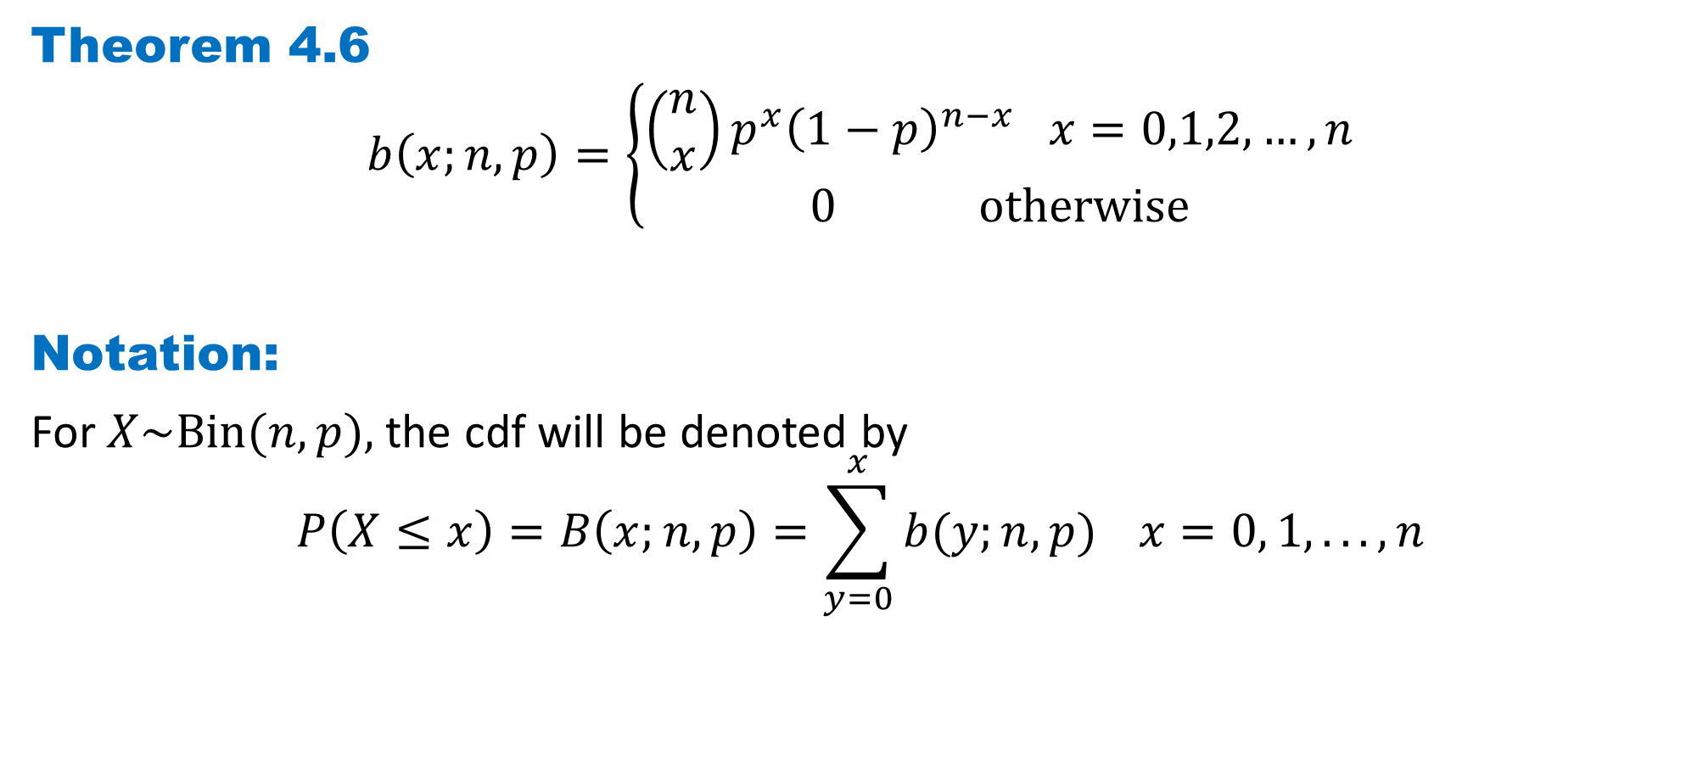
DLI
Theorem 4.6
$$b\left(x;n, p\right)=\left\{\begin{aligned}\left(\begin{matrix}n \\ x\end{matrix}\right)p^{x}{\left(1−p\right)}^{n−x} x=0,1,2,…,n \\ 0 otherwise\end{aligned}\right.$$
Notation:
For $X\sim Bin(n, p),$the cdf will be denoted by
$$P\left(X≤x\right)=B\left(x;n, p\right)=\sum_{y=0}^{x}{b(y;n, p)} x=0, 1, . . . , n$$

Slide 33
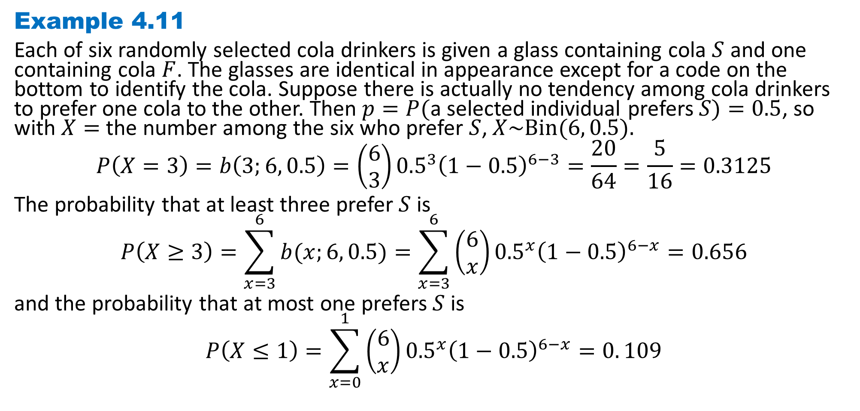
DLI
Example 4.11
Each of six randomly selected cola drinkers is given a glass containing cola $S$ and one containing cola $F$. The glasses are identical in appearance except for a code on the bottom to identify the cola. Suppose there is actually no tendency among cola drinkers to prefer one cola to the other. Then $p=P($a selected individual prefers $S)=0.5$, so with $X=$the number among the six who prefer $S$, $X\sim Bin(6, 0.5).$
$$P\left(X=3\right)=b\left(3;6, 0.5\right)=\left(\begin{matrix}6 \\ 3\end{matrix}\right){0.5}^{3}{\left(1−0.5\right)}^{6−3}=\frac{20}{64}=\frac{5}{16}=0.3125$$
The probability that at least three prefer $S$ is
$$P\left(X≥3\right)=\sum_{x=3}^{6}{b(x;6, 0.5)}=\sum_{x=3}^{6}{\left(\begin{matrix}6 \\ x\end{matrix}\right){0.5}^{x}{\left(1−0.5\right)}^{6−x}}=0.656$$
and the probability that at most one prefers $S$ is
$$P\left(X≤1\right)=\sum_{x=0}^{1}{\left(\begin{matrix}6 \\ x\end{matrix}\right){0.5}^{x}{\left(1−0.5\right)}^{6−x}}=0. 109$$

Slide 34
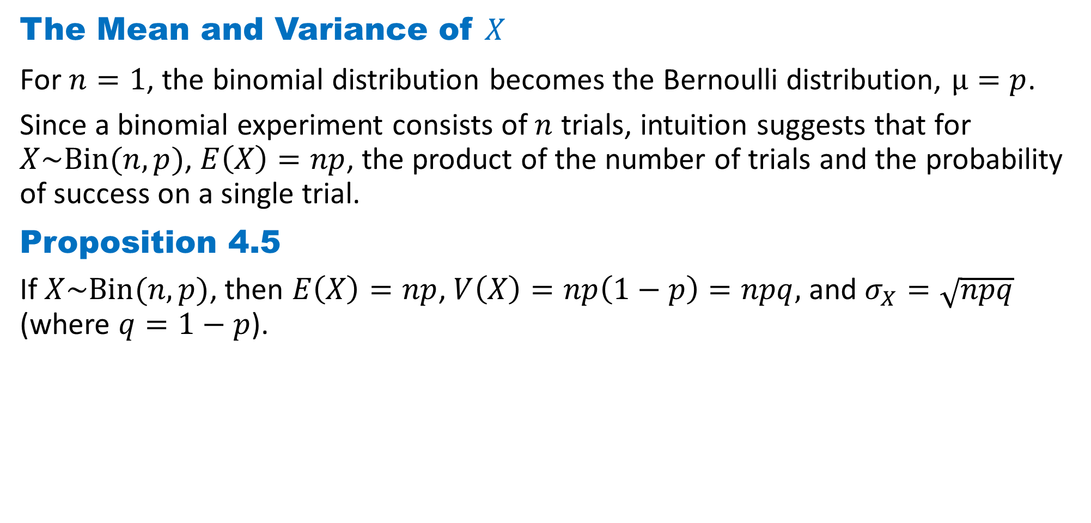
DLI
The Mean and Variance of $X$
For $n=1$, the binomial distribution becomes the Bernoulli distribution, $μ=p$.
Since a binomial experiment consists of $n$ trials, intuition suggests that for $X\sim Bin(n, p)$, $E\left(X\right)=np$, the product of the number of trials and the probability of success on a single trial.
Proposition 4.5
If $X\sim Bin(n, p)$, then $E\left(X\right)=np$, $V\left(X\right)=np\left(1−p\right)=npq,$ and $σ_{X}=\sqrt{npq}$ (where $q=1−p$).

Slide 35
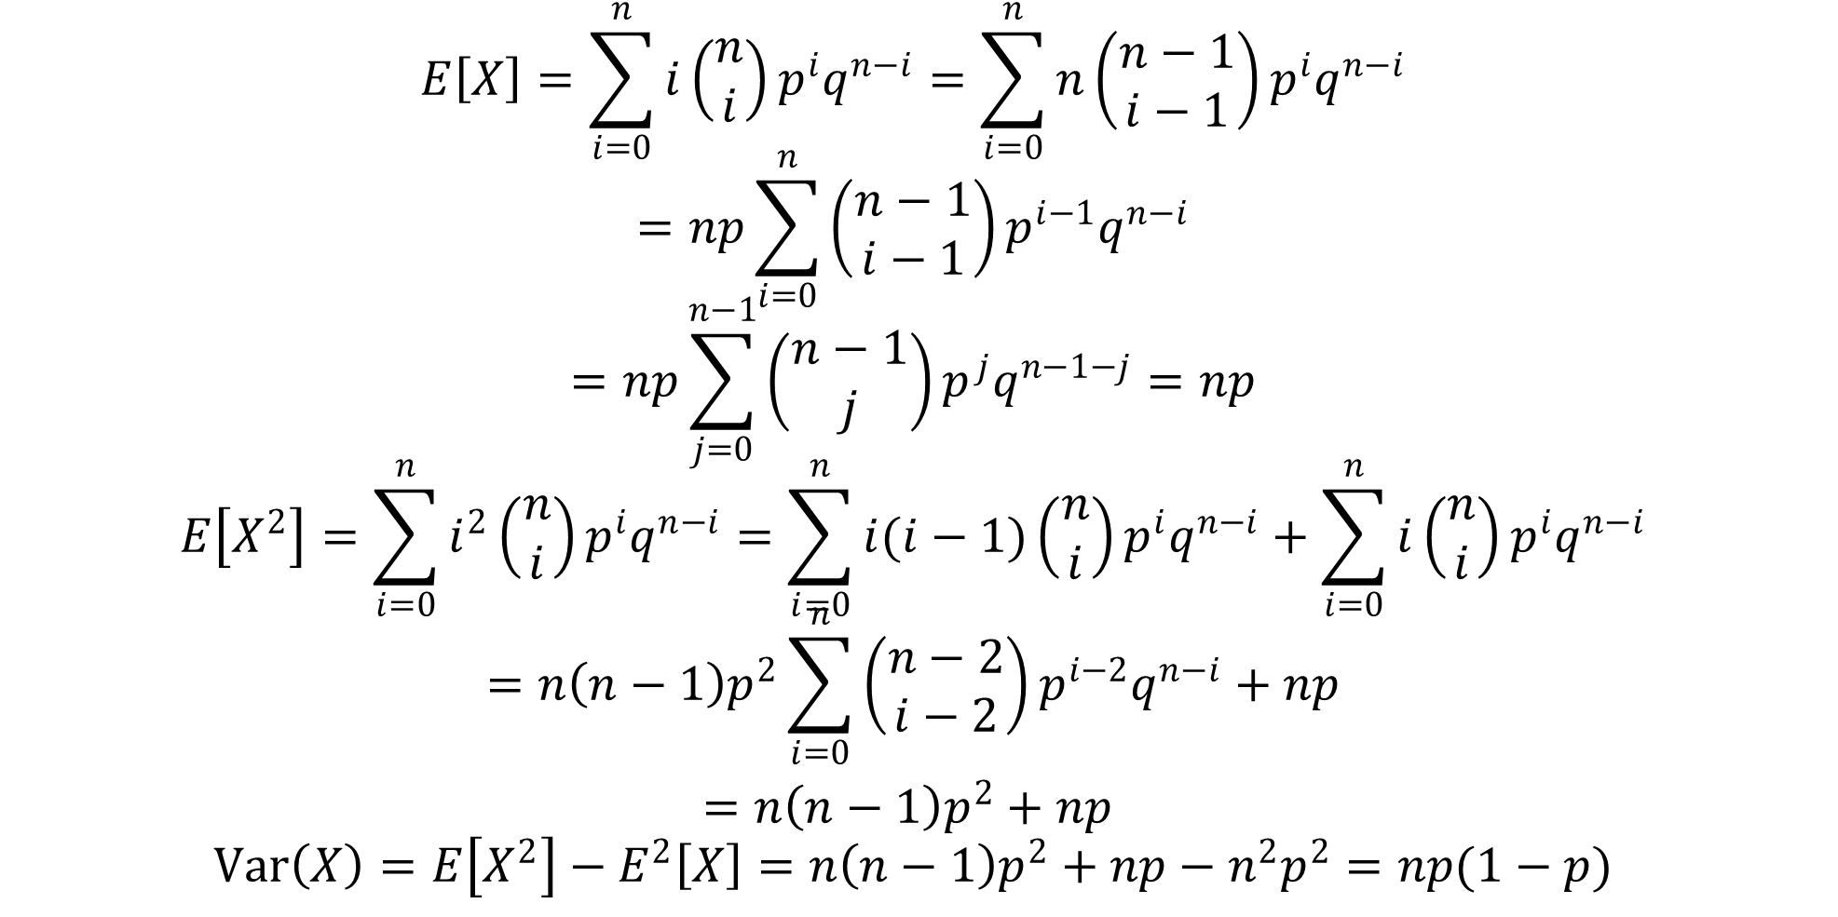
DLI
$$E\left[X\right]=\sum_{i=0}^{n}{i\left(\begin{matrix}n \\ i\end{matrix}\right){p^{i}q}^{n−i}}=\sum_{i=0}^{n}{n\left(\begin{matrix}n−1 \\ i−1\end{matrix}\right){p^{i}q}^{n−i}}$$
$$=np\sum_{i=0}^{n}{\left(\begin{matrix}n−1 \\ i−1\end{matrix}\right){p^{i−1}q}^{n−i}}$$
$$=np\sum_{j=0}^{n−1}{\left(\begin{matrix}n−1 \\ j\end{matrix}\right){p^{j}q}^{n−1−j}}=np$$
$$E\left[X^{2}\right]=\sum_{i=0}^{n}{i^{2}\left(\begin{matrix}n \\ i\end{matrix}\right){p^{i}q}^{n−i}}=\sum_{i=0}^{n}{i(i−1)\left(\begin{matrix}n \\ i\end{matrix}\right){p^{i}q}^{n−i}}+\sum_{i=0}^{n}{i\left(\begin{matrix}n \\ i\end{matrix}\right){p^{i}q}^{n−i}}$$
$$=n\left(n−1\right)p^{2}\sum_{i=0}^{n}{\left(\begin{matrix}n−2 \\ i−2\end{matrix}\right){p^{i−2}q}^{n−i}}+np$$
$=n\left(n−1\right)p^{2}+np$
$$Var\left(X\right)=E\left[X^{2}\right]−E^{2}\left[X\right]=n\left(n−1\right)p^{2}+np−n^{2}p^{2}=np(1−p)$$

Slide 36
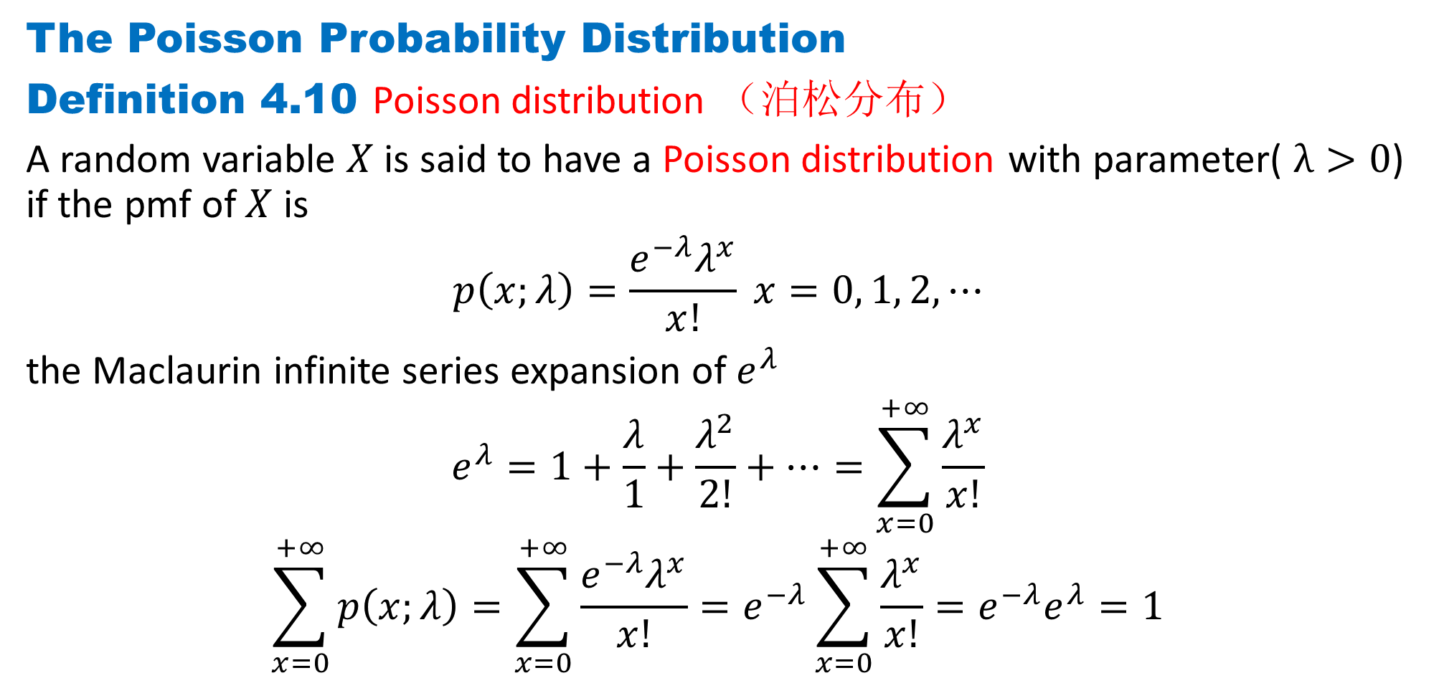
DLI
The Poisson Probability Distribution
Definition 4.10 Poisson distribution （泊松分布）
A random variable $X$ is said to have a Poisson distribution with parameter( $λ>0$) if the pmf of $X$ is
$$p\left(x;λ\right)=\frac{e^{−λ}λ^{x}}{x!} x=0, 1, 2, ⋯$$
the Maclaurin infinite series expansion of $e^{λ}$
$$e^{λ}=1+\frac{λ}{1}+\frac{λ^{2}}{2!}+⋯=\sum_{x=0}^{+∞}{\frac{λ^{x}}{x!}}$$
$$\sum_{x=0}^{+∞}{p\left(x;λ\right)}=\sum_{x=0}^{+∞}{\frac{{e^{−λ}λ}^{x}}{x!}}=e^{−λ}\sum_{x=0}^{+∞}{\frac{λ^{x}}{x!}}=e^{−λ}e^{λ}=1$$

Slide 37
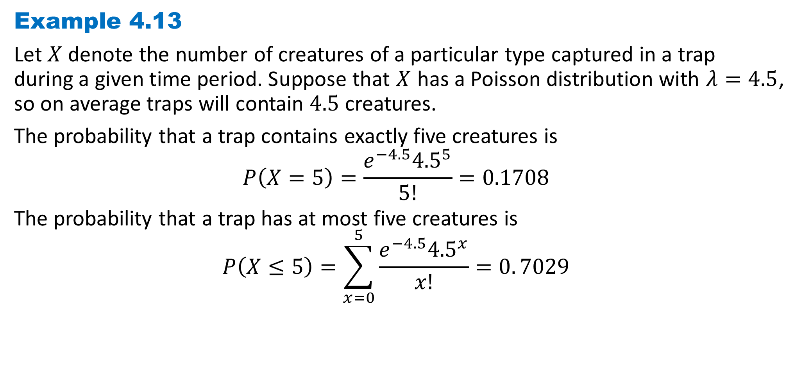
DLI
Example 4.13
Let $X$ denote the number of creatures of a particular type captured in a trap during a given time period. Suppose that $X$ has a Poisson distribution with $λ=4.5$, so on average traps will contain $4.5$ creatures.
The probability that a trap contains exactly five creatures is
$$P\left(X=5\right)=\frac{e^{−4.5}{4.5}^{5}}{5!}=0.1708$$
The probability that a trap has at most five creatures is
$$P\left(X≤5\right)=\sum_{x=0}^{5}{\frac{e^{−4.5}{4.5}^{x}}{x!}}=0. 7029$$

Slide 38
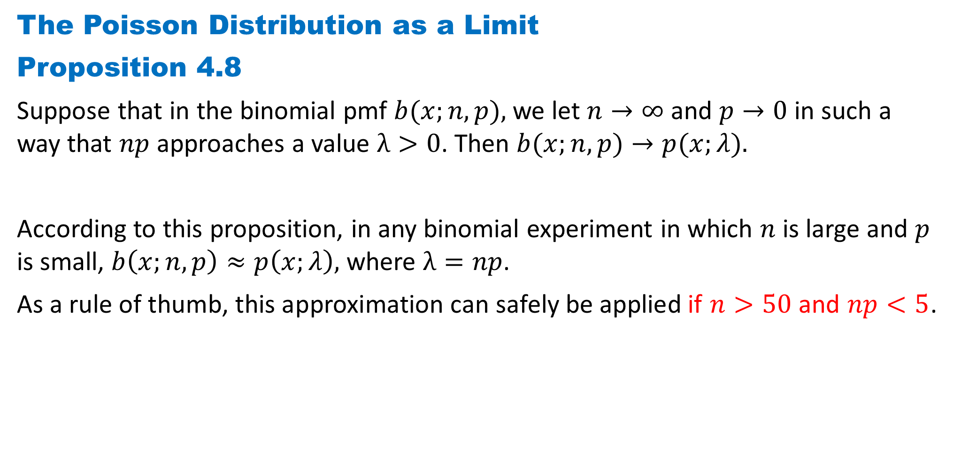
DLI
The Poisson Distribution as a Limit
Proposition 4.8
Suppose that in the binomial pmf $b(x;n, p),$we let $n→∞$ and $p→0$ in such a way that $np$ approaches a value $λ>0$. Then $b(x;n, p)→p(x;λ).$
According to this proposition, in any binomial experiment in which $n$ is large and $p$ is small, $b\left(x;n, p\right)≈p\left(x;λ\right),$ where $λ=np$.
As a rule of thumb, this approximation can safely be applied if $n>50$and $np<5$.

Slide 39
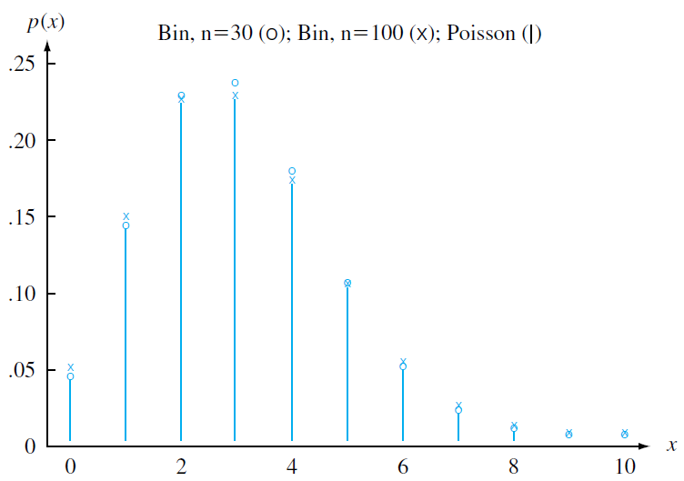
DLI
Comparing a Poisson and two binomial distributions

Slide 40
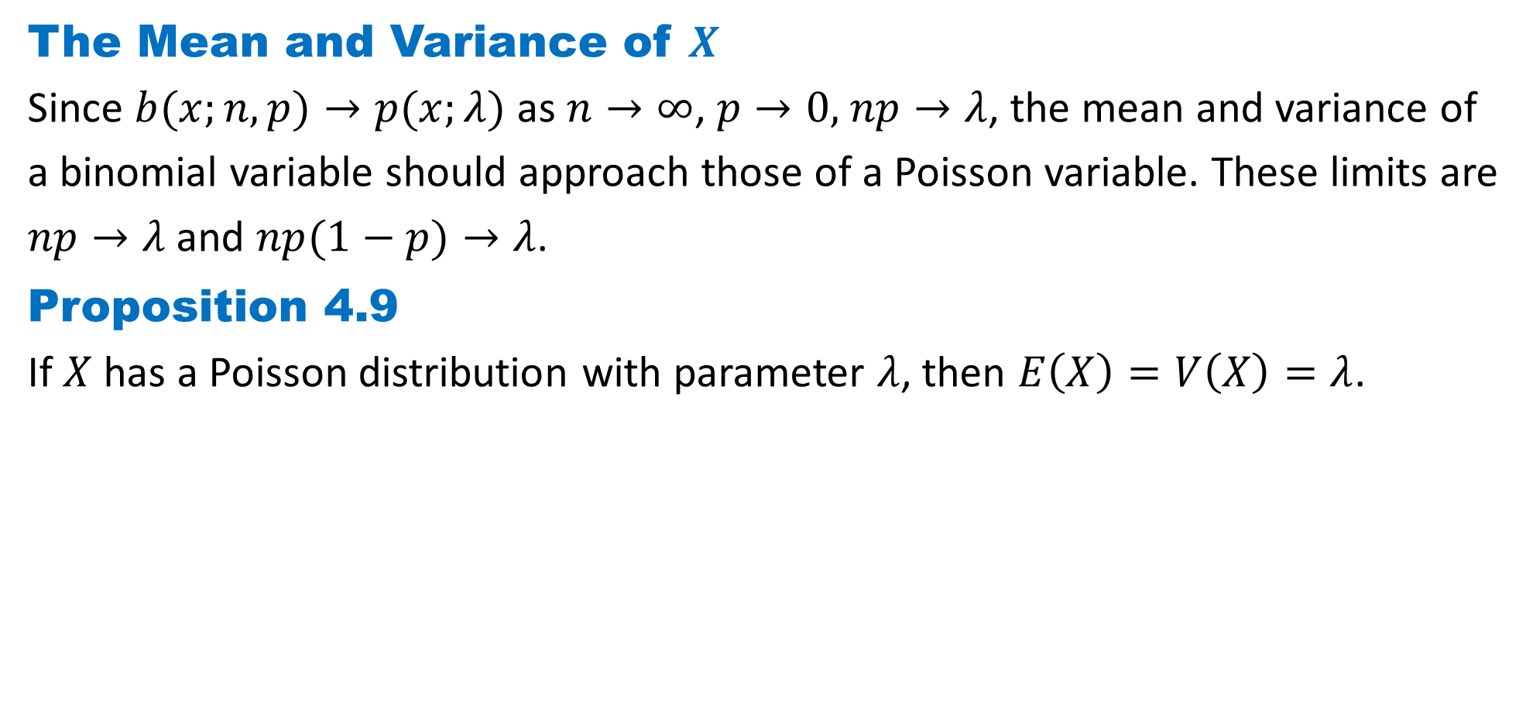
DLI
The Mean and Variance of $X$
Since $b(x;n, p)→p(x;λ)$as $n→∞$, $p→0,$ $np→λ$, the mean and variance of
a binomial variable should approach those of a Poisson variable. These limits are
$np→λ$ and $np(1−p)→λ$.
Proposition 4.9
If $X$ has a Poisson distribution with parameter $λ$, then $E\left(X\right)=V\left(X\right)=λ$.

Slide 41
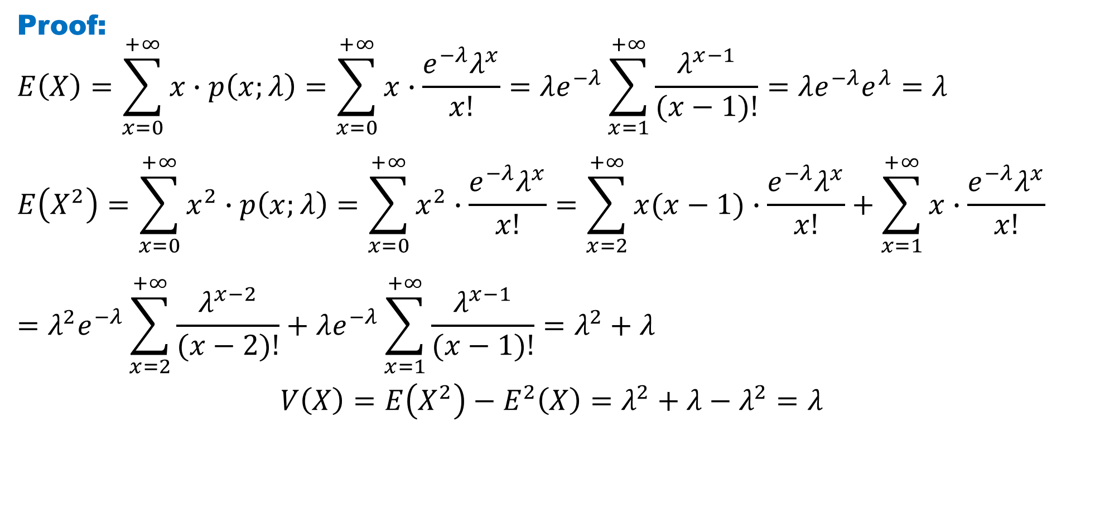
DLI
Proof:
$$E\left(X\right)=\sum_{x=0}^{+∞}{x∙p\left(x;λ\right)}=\sum_{x=0}^{+∞}{x∙\frac{{e^{−λ}λ}^{x}}{x!}}=λe^{−λ}\sum_{x=1}^{+∞}{\frac{λ^{x−1}}{(x−1)!}}=λe^{−λ}e^{λ}=λ$$
$$E\left(X^{2}\right)=\sum_{x=0}^{+∞}{x^{2}∙p\left(x;λ\right)}=\sum_{x=0}^{+∞}{x^{2}∙\frac{{e^{−λ}λ}^{x}}{x!}}=\sum_{x=2}^{+∞}{x(x−1)∙\frac{{e^{−λ}λ}^{x}}{x!}}+\sum_{x=1}^{+∞}{x∙\frac{{e^{−λ}λ}^{x}}{x!}}=λ^{2}e^{−λ}\sum_{x=2}^{+∞}{\frac{λ^{x−2}}{(x−2)!}}+λe^{−λ}\sum_{x=1}^{+∞}{\frac{λ^{x−1}}{(x−1)!}}=λ^{2}+λ$$
$$V\left(X\right)=E\left(X^{2}\right)−E^{2}\left(X\right)=λ^{2}+λ−λ^{2}=λ$$

Slide 42
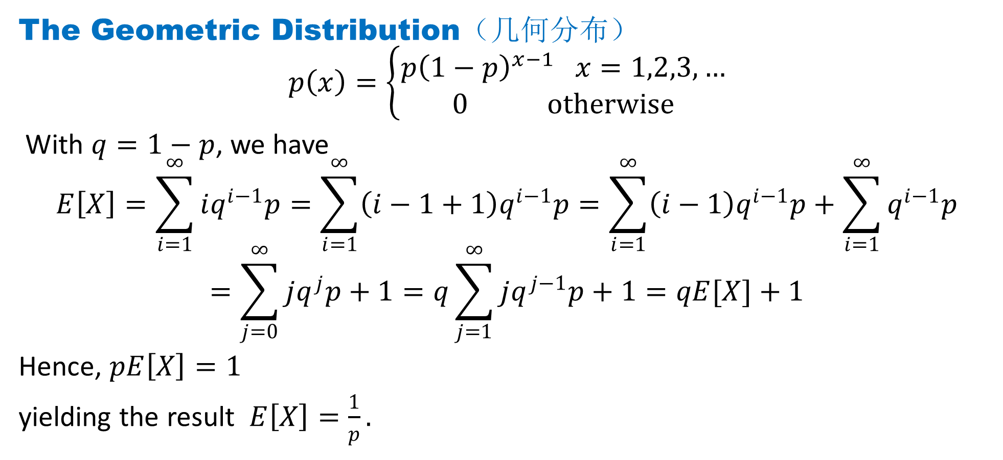
DLI
The Geometric Distribution（几何分布）
$$p\left(x\right)=\left\{\begin{aligned}p{\left(1−p\right)}^{x−1} x=1,2,3,… \\ 0 otherwise\end{aligned}\right.$$
With $q=1−p$, we have
$$E\left[X\right]=\sum_{i=1}^{∞}{iq^{i−1}p}=\sum_{i=1}^{∞}{\left(i−1+1\right)q^{i−1}p}=\sum_{i=1}^{∞}{\left(i−1\right)q^{i−1}p}+\sum_{i=1}^{∞}{q^{i−1}p}$$
$$=\sum_{j=0}^{∞}{jq^{j}p}+1=q\sum_{j=1}^{∞}{jq^{j−1}p}+1=qE[X]+1$$
Hence, $pE\left[X\right]=1$
yielding the result $E\left[X\right]=\frac{1}{p}.$

Slide 43

DLI
$$E[X^{2}]=\sum_{i=1}^{∞}{i^{2}q^{i−1}p}=\sum_{i=1}^{∞}{{\left(i−1+1\right)}^{2}q^{i−1}p}$$
$$=\sum_{i=1}^{∞}{{\left(i−1\right)}^{2}q^{i−1}p}+2\sum_{i=1}^{∞}{(i−1)q^{i−1}p}+\sum_{i=1}^{∞}{q^{i−1}p}$$
$$=\sum_{j=0}^{∞}{j^{2}q^{j}p}+2qE[X]+1=qE[X^{2}]+2qE[X]+1$$
Using $E\left[X\right]=\frac{1}{p}$, we get $pE\left[X^{2}\right]=\frac{2q}{p}+1$. Hence
$$E\left[X^{2}\right]=\frac{2q+p}{p^{2}}=\frac{q+1}{p^{2}}$$
$$Var\left(X\right)=E\left[X^{2}\right]−E^{2}\left[X\right]=\frac{q+1}{p^{2}}−\frac{1}{p^{2}}=\frac{q}{p^{2}}=\frac{1−p}{p^{2}}$$

Slide 44

DLI
$$p\left(x\right)=\left\{\begin{aligned}p{\left(1−p\right)}^{x−1} x=1,2,3,… \\ 0 otherwise\end{aligned}\right.$$
Another method:
$$E\left(X\right)=\sum_{x∈D}{x . p(x) }=\sum_{x=1}^{∞}{x .p{\left(1−p\right)}^{x−1}}=p\sum_{x=1}^{∞}{[−\frac{d}{dp}{\left(1−p\right)}^{x}}]$$
$$=−p\frac{d}{dp}\sum_{x=1}^{∞}{{\left(1−p\right)}^{x}}=−p\frac{d}{dp}\left[\frac{1−p}{1−\left(1−p\right)}\right]=−p\frac{d}{dp}\left[\frac{1}{p}−1\right]=\frac{1}{p}$$
yielding the result $E\left[X\right]=\frac{1}{p}.$

Slide 45

DLI
$$E\left(X^{2}\right)=\sum_{x∈D}{x^{2} . p(x) }=\sum_{x=1}^{∞}{x^{2} .p{\left(1−p\right)}^{x−1}}$$
$$=\sum_{x=1}^{∞}{x(x+1) .p{\left(1−p\right)}^{x−1}}−\sum_{x=1}^{∞}{x .p{\left(1−p\right)}^{x−1}}$$
$$=p\sum_{x=1}^{∞}{[\frac{d^{2}}{dp^{2}}{\left(1−p\right)}^{x+1}}]−\frac{1}{p}$$
$$=p\frac{d^{2}}{dp^{2}}\sum_{x=1}^{∞}{{\left(1−p\right)}^{x+1}}=p\frac{d^{2}}{dp^{2}}\left[\frac{{\left(1−p\right)}^{2}}{1−\left(1−p\right)}\right]−\frac{1}{p}=p\frac{d^{2}}{dp^{2}}\left[\frac{1}{p}−2+p\right]−\frac{1}{p}=\frac{2}{p^{2}}−\frac{1}{p}$$
$$Var\left(X\right)=E\left[X^{2}\right]−E^{2}\left[X\right]=\frac{2}{p^{2}}−\frac{1}{p}−\frac{1}{p^{2}}=\frac{q}{p^{2}}=\frac{1−p}{p^{2}}$$

Slide 46

DLI
The Negative Binomial Random Variable（负二项分布）
Suppose that independent trials, each having probability $p, 0<p<1$, of being a success are performed until a total of $r$ successes is accumulated.
$$p\left(n\right)=P\left\{X=n\right\}=\left(\begin{matrix}n−1 \\ r−1\end{matrix}\right)p^{r}{\left(1−p\right)}^{n−r}$$
$$E\left[X^{k}\right]=\sum_{n=r}^{∞}{n^{k}\left(\begin{matrix}n−1 \\ r−1\end{matrix}\right)p^{r}{\left(1−p\right)}^{n−r}}=\frac{r}{p}\sum_{n=r}^{∞}{n^{k−1}\left(\begin{matrix}n \\ r\end{matrix}\right)p^{r+1}{\left(1−p\right)}^{n−r}}=\frac{r}{p}\sum_{m=r+1}^{∞}{{(m−1)}^{k−1}\left(\begin{matrix}m−1 \\ r\end{matrix}\right)p^{r+1}{\left(1−p\right)}^{m−(r+1)}}$$
$$=\frac{r}{p}E[{\left(Y−1\right)}^{k−1}]$$
where $Y$ is a negative binomial random variable with parameters $r+1,p$.

Slide 47

DLI
Setting $k=1$in the preceding equation yields
$$E[X]=\frac{r}{p}$$
Setting $k=2$and using the formula for the expected value of a negative binomial random variable gives
$$E\left[X^{2}\right]=\frac{r}{p}E\left[Y−1\right]=\frac{r}{p}\left(\frac{r+1}{p}−1\right)$$
Therefore,
$$Var\left(X\right)=E\left[X^{2}\right]−E^{2}\left[X\right]=\frac{r}{p}\left(\frac{r+1}{p}−1\right)−{\left(\frac{r}{p}\right)}^{2}$$
$$=\frac{r(1−p)}{p^{2}}$$

Slide 48

DLI
The Hypergeometric Random Variable（超几何分布）
Suppose that a sample of size $n$ is to be chosen randomly (without replacement) from an urn containing $N$ balls, of which $m$ are white and $N−m$are black. If we let $X$ denote the number of white balls selected, then
$$p\left(i\right)=P\left\{X=i\right\}=\frac{\left(\begin{matrix}m \\ i\end{matrix}\right)\left(\begin{matrix}N−m \\ n−i\end{matrix}\right)}{\left(\begin{matrix}N \\ n\end{matrix}\right)}, i=0,1,…,n$$
Remark: Although we have written the hypergeometric probability mass function with $i$ going from $0$ to $n$, $P\{X=i\}$will actually be $0$, unless $i$satisfies the inequalities $n−(N−m)≤i≤ min⁡(n,m).$ However, it is always valid because of our convention that $\left(\begin{matrix}r \\ k\end{matrix}\right)$ is equal to 0 when either $k<0$or $r<k$.

Slide 49

DLI
$$E\left[X^{k}\right]=\sum_{i=0}^{n}{i^{k}\frac{\left(\begin{matrix}m \\ i\end{matrix}\right)\left(\begin{matrix}N−m \\ n−i\end{matrix}\right)}{\left(\begin{matrix}N \\ n\end{matrix}\right)}}=\frac{nm}{N}\sum_{i=1}^{n}{i^{k−1}\frac{\left(\begin{matrix}m−1 \\ i−1\end{matrix}\right)\left(\begin{matrix}N−m \\ n−i\end{matrix}\right)}{\left(\begin{matrix}N−1 \\ n−1\end{matrix}\right)}}$$
$$=\frac{nm}{N}\sum_{j=0}^{n−1}{{\left(j+1\right)}^{k−1}\frac{\left(\begin{matrix}m−1 \\ j\end{matrix}\right)\left(\begin{matrix}N−m \\ n−1−j\end{matrix}\right)}{\left(\begin{matrix}N−1 \\ n−1\end{matrix}\right)}}=\frac{nm}{N}E[{\left(Y+1\right)}^{k−1}]$$
where $Y$ is a hypergeometric random variable with parameters $n−1, N−1$, and $m−1$. Hence, upon setting $k=1$, we have
$$E[X]=\frac{nm}{N}$$
In words, if $n$ balls are randomly selected from a set of $N$ balls, of which $m$ are white, then the expected number of white balls selected is $nm/N$.

Slide 50

DLI
Upon setting $k=2$in the equation for $E[X^{k}]$, we obtain
$$E\left[X^{2}\right]=\frac{nm}{N}E[Y+1]=\frac{nm}{N}\left(\frac{ (n−1)(m−1)}{N−1}+1\right)$$
Therefore,
$$Var\left(X\right)=E\left[X^{2}\right]−E^{2}\left[X\right]=\frac{nm}{N}\left(\frac{ (n−1)(m−1)}{N−1}+1−\frac{nm}{N}\right)$$

Slide 51
DLI
Homework
Page 174 Problems
1, 10, 13, 17, 19, 32, 52,
Page 180 Theoretical Exercises
4, 7, 9, 27
Page 184 Self-Test Problems and Exercises
2, 5, 9, 21

